Slide 1
An NSS Audio-Visual
Library Presentation
ConCave I
A Cave Restoration Project of
Cave Conservancy of the Virginias
and Virginia Region of the NSS
(1983)
S203 74 Slides 1/21/2021
Notes:
In the fall of 1983, the Cave Conservancy of the Virginias and the Virginia Region of the National Speleological Society sponsored the cleanup and reconstruction of Fountain Cave near Grottoes, Virginia. The slides that follow document the event.

Slide 2
An NSS Audio-Visual
Library Presentation
ConCave I
October 1983
Virginia Region Meeting
at
Fountain Cave, Grottoes, VA
Notes:
The setting was a typical Virginia Region meeting much like any NSS region might have.

Slide 3
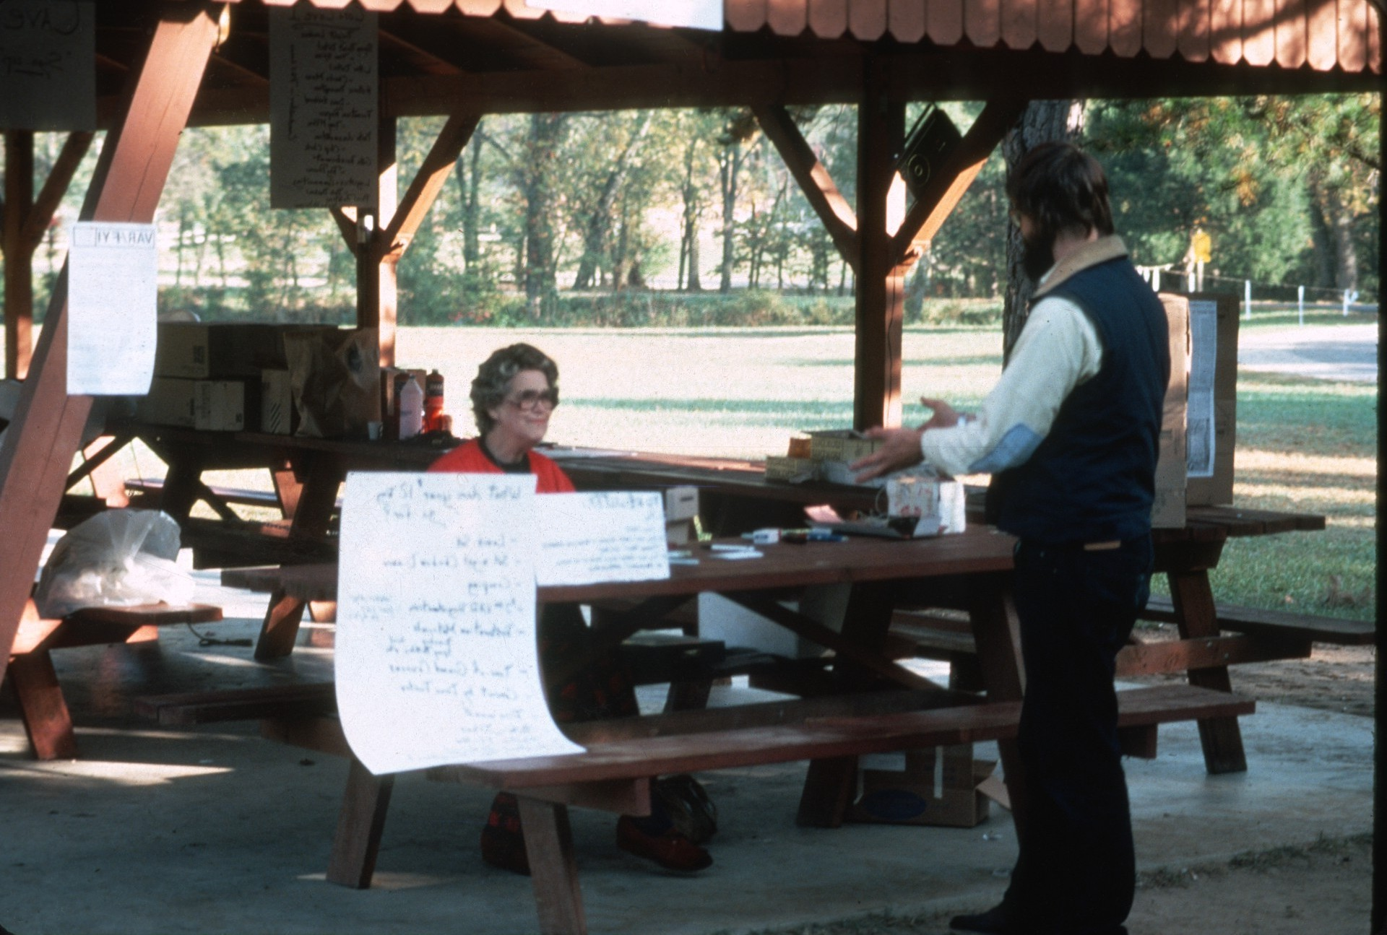
Notes:
For months the region newsletter had asked cavers throughout the area to come and help.

Slide 4
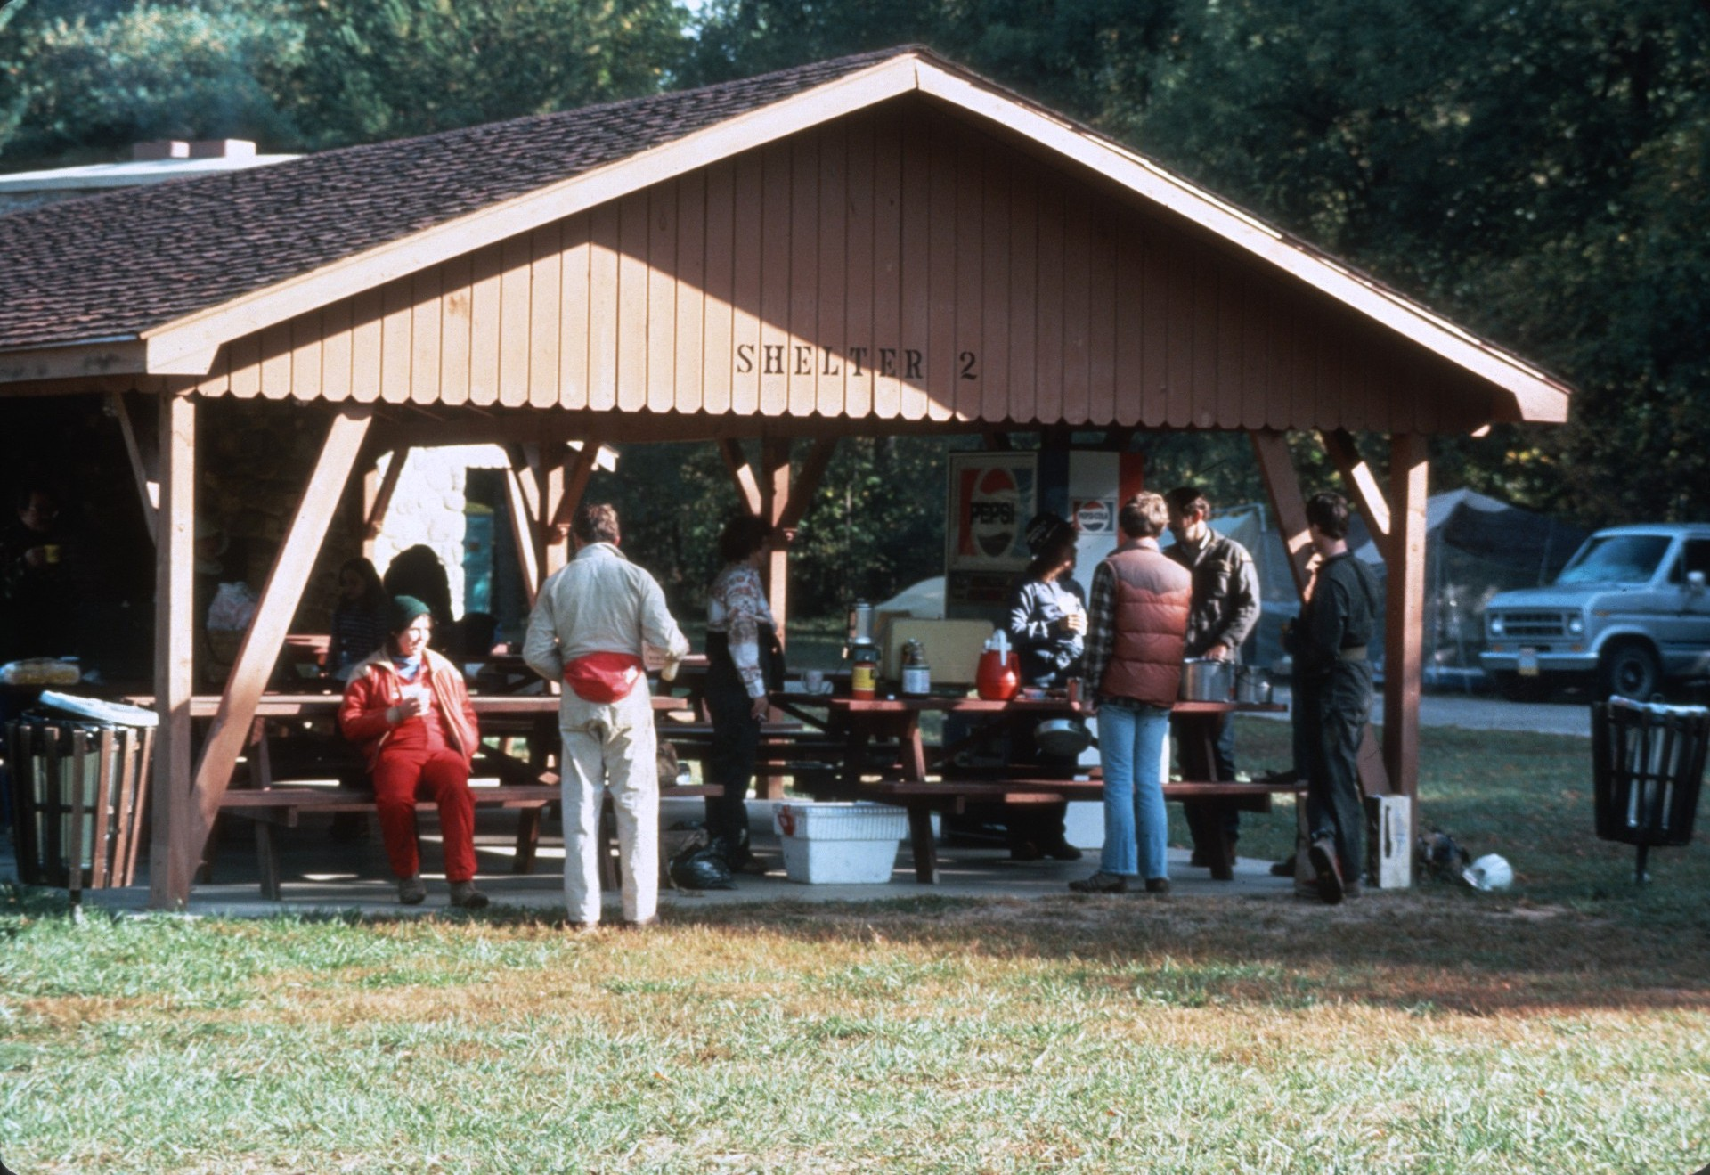
Notes:
More than 200 came to participate.

Slide 5
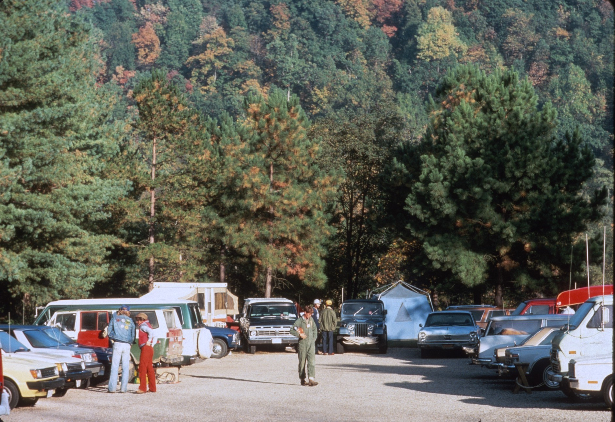
Notes:
Before the meeting the organizers had arranged for all the necessary supplies and now the task was to carry them to the cave.

Slide 6
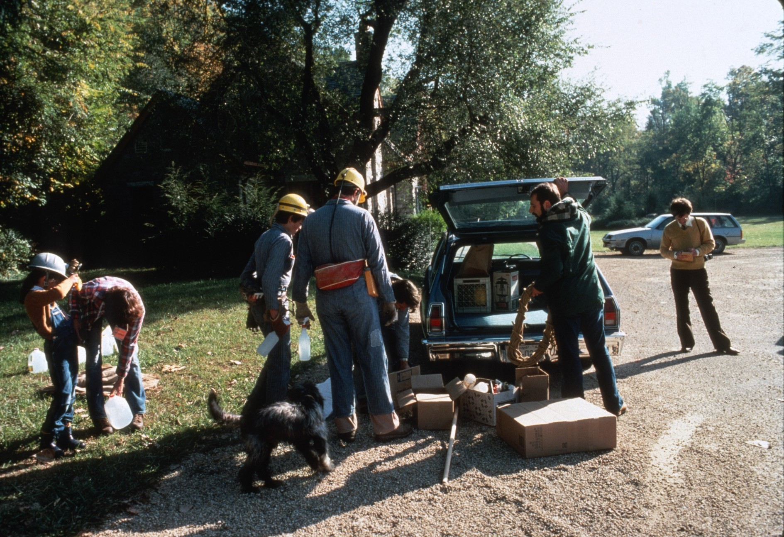

Slide 7
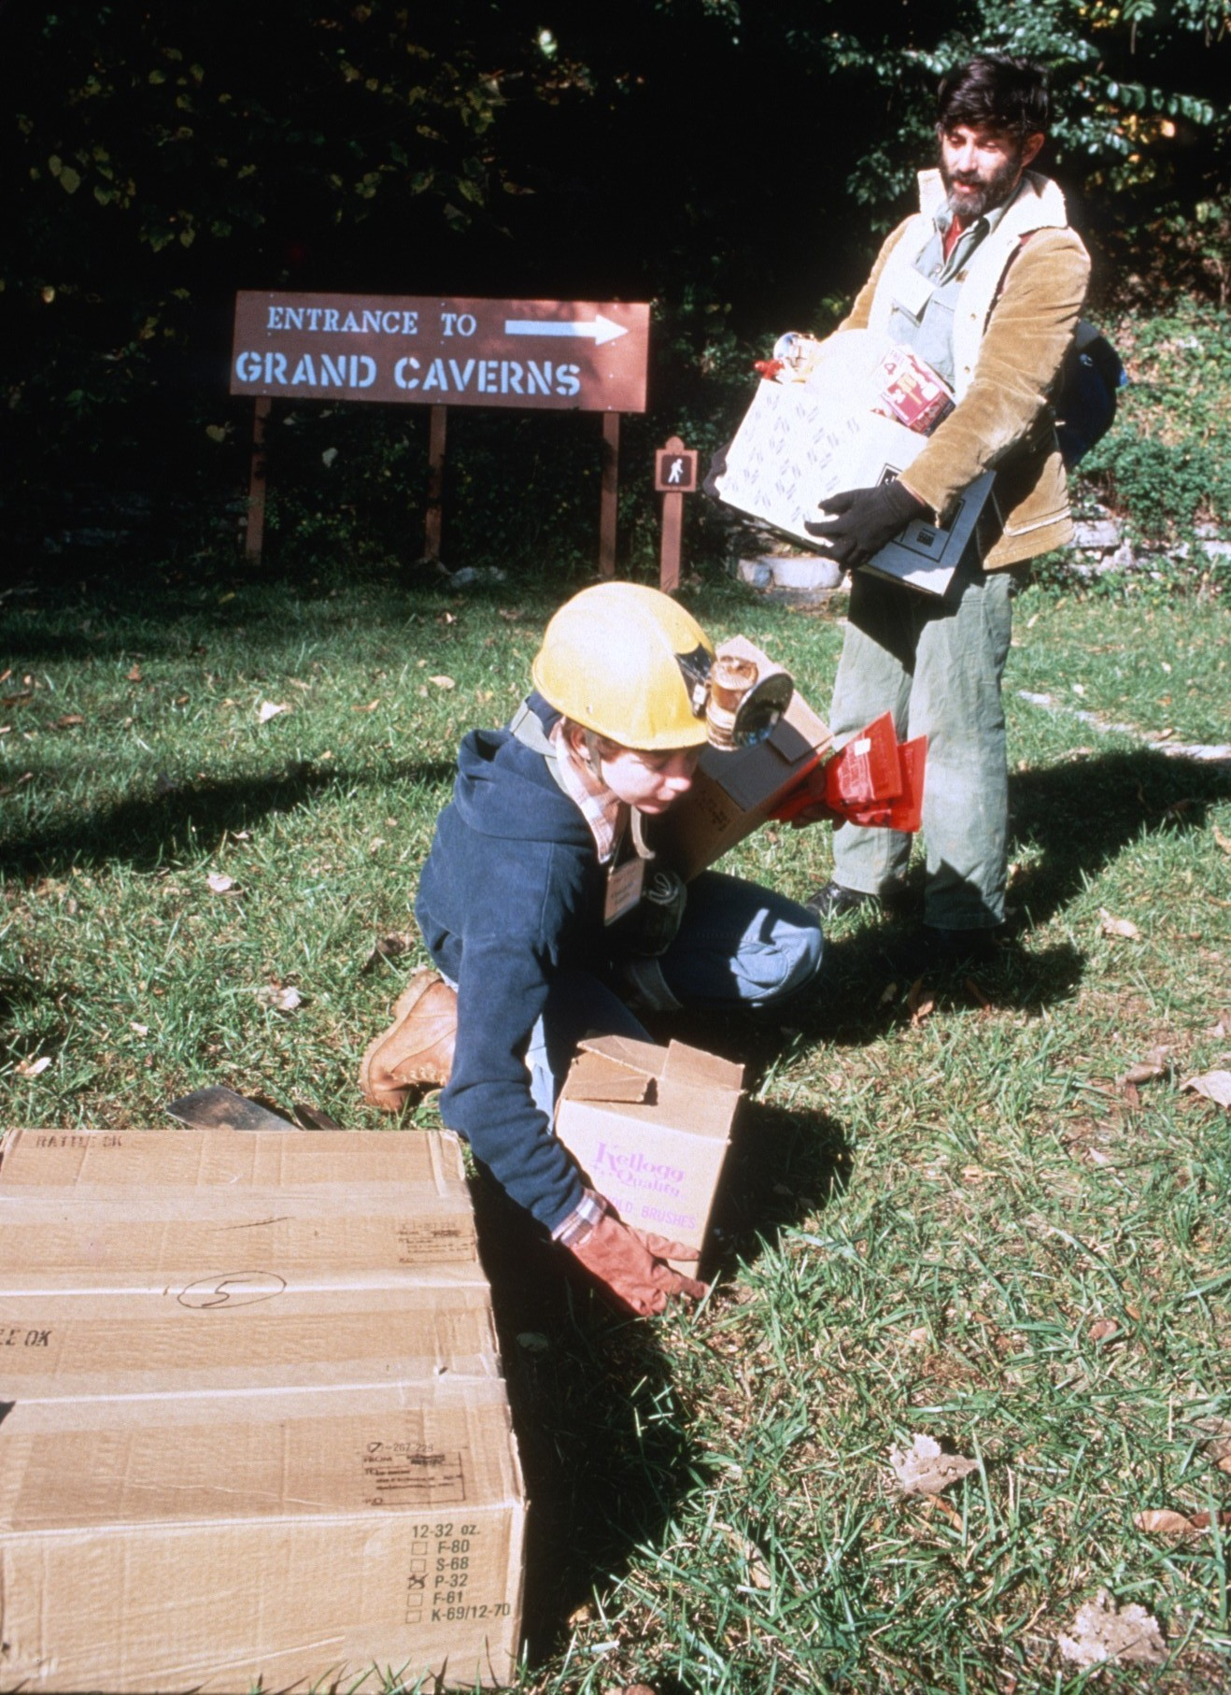

Slide 8
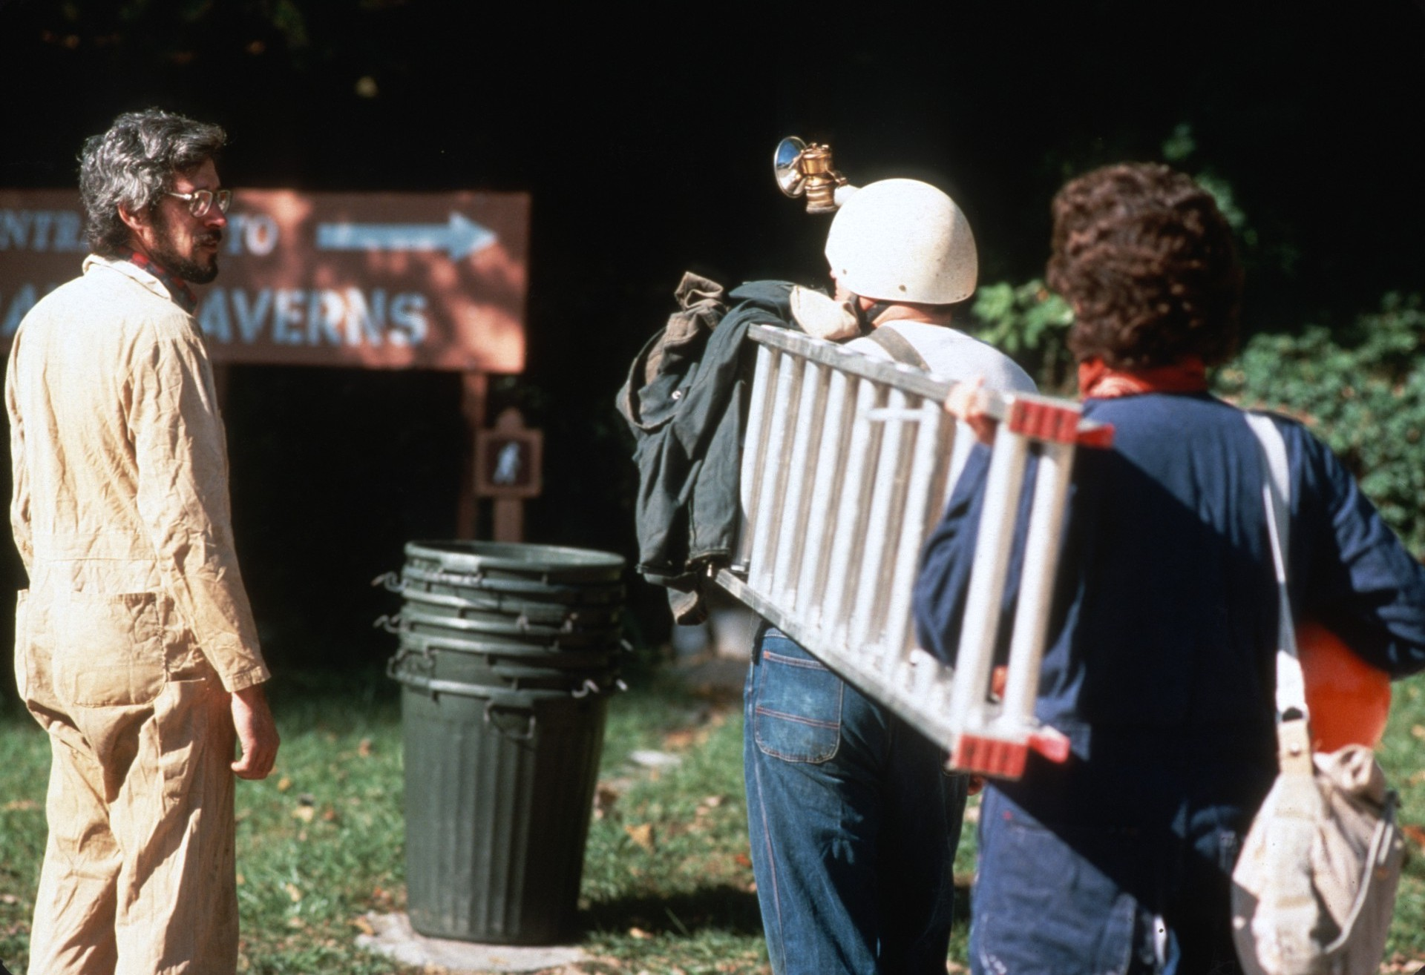
Notes:
The local press had been contacted and when they arrived they were given material they could use in their story.

Slide 9
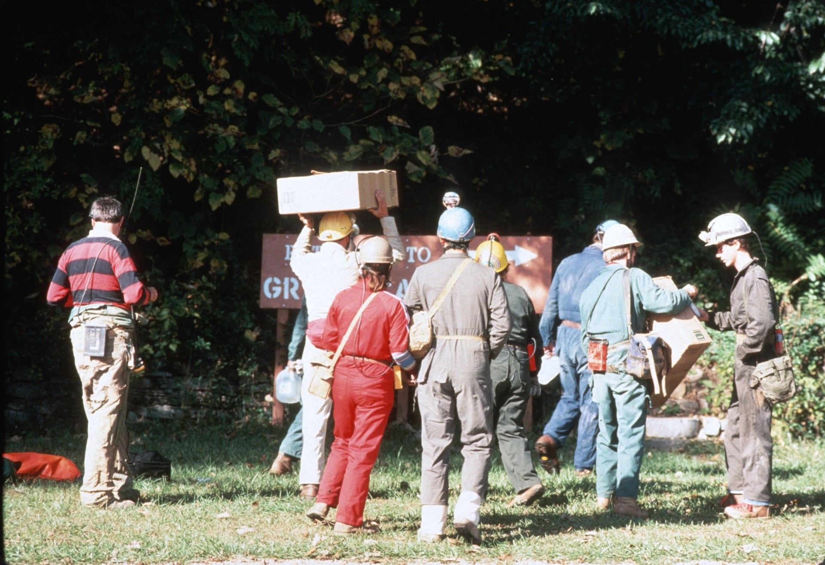

Slide 10
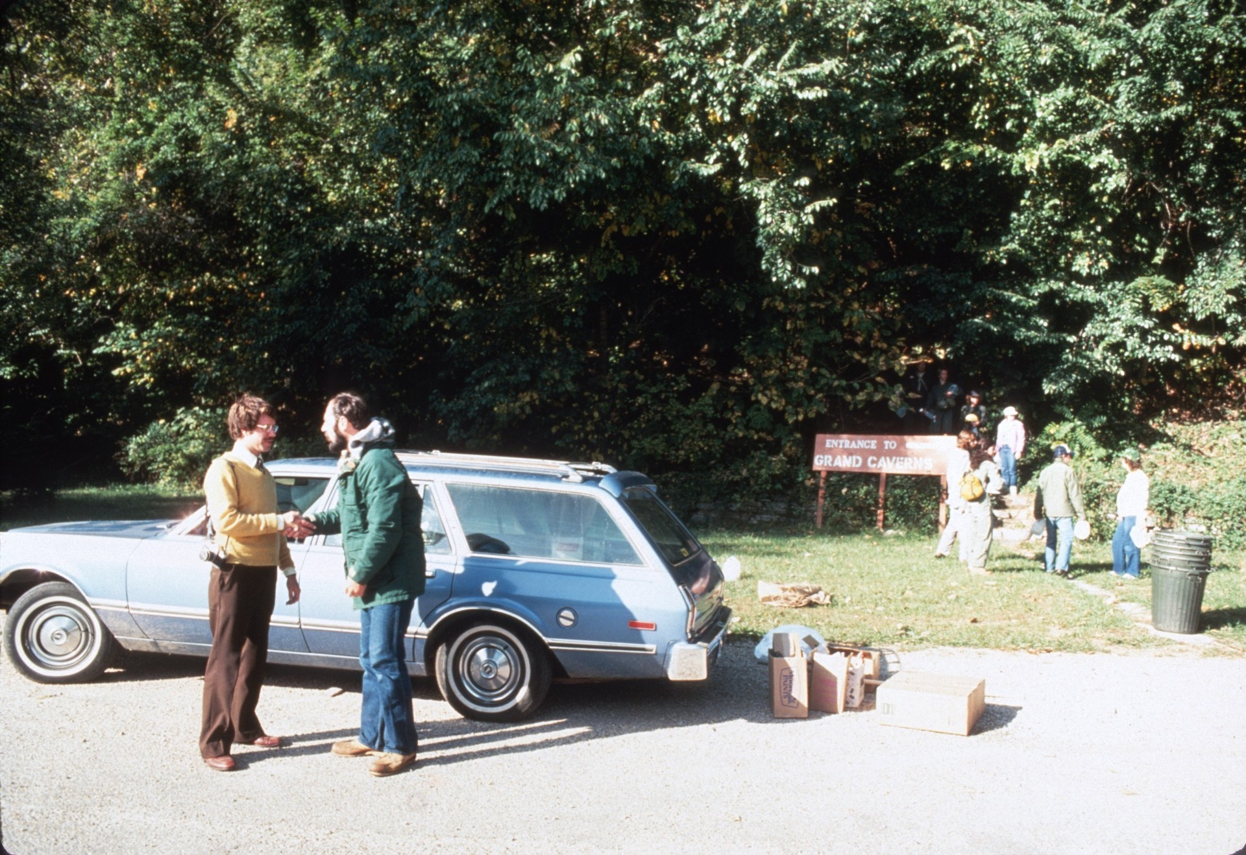

Slide 11
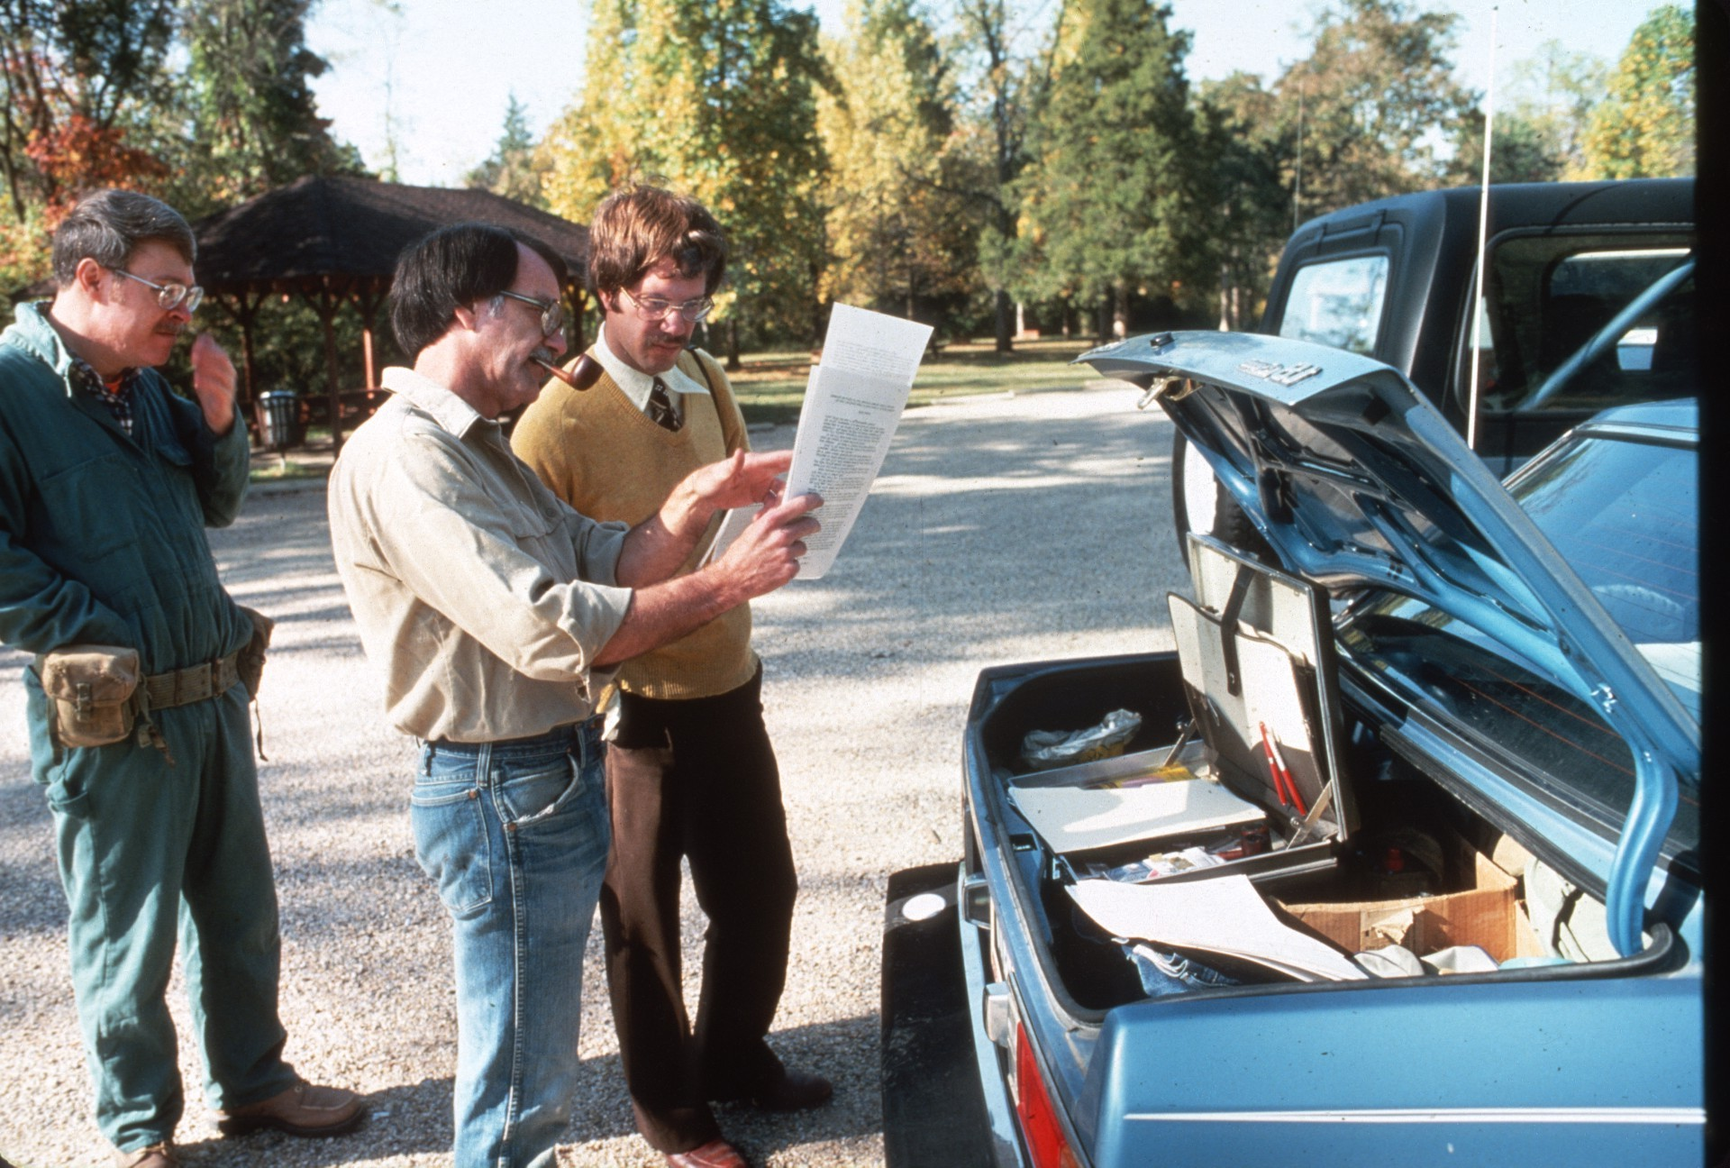

Slide 12
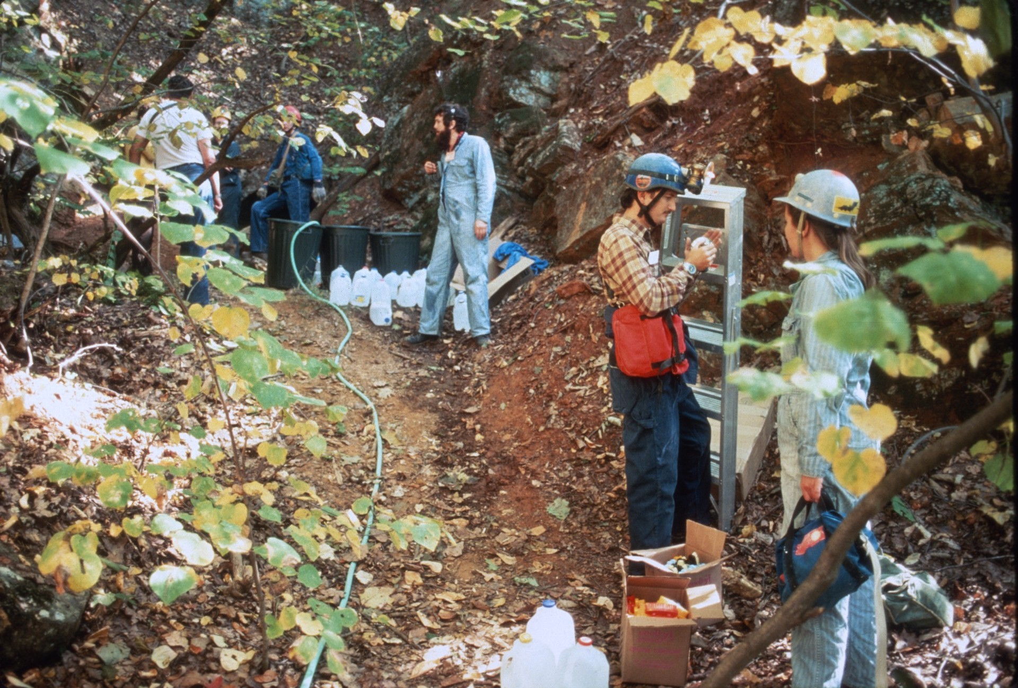
Notes:
Supplies piled up in front of the cave.

Slide 13
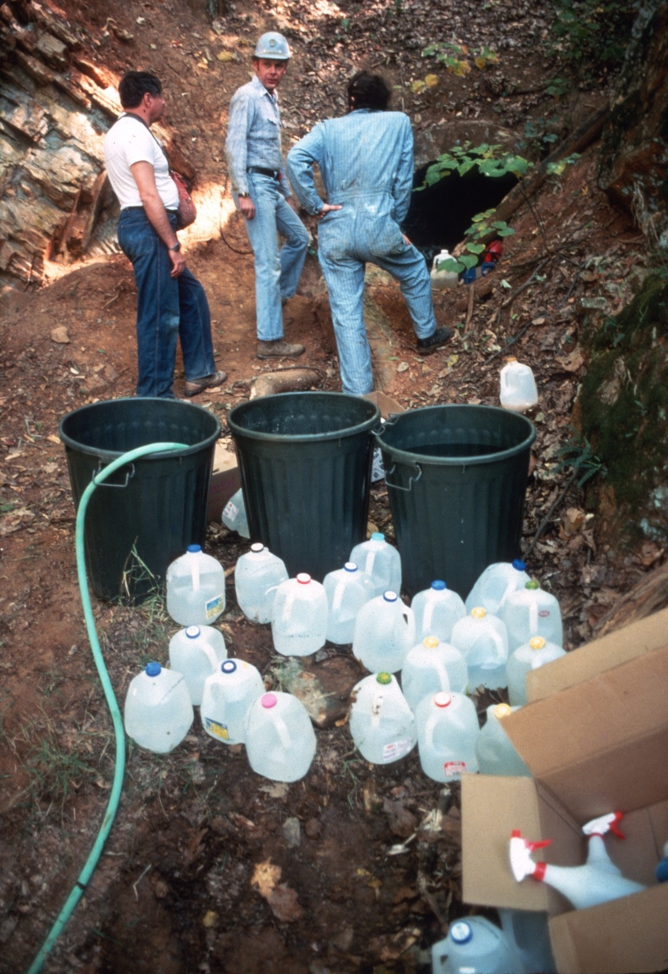

Slide 14
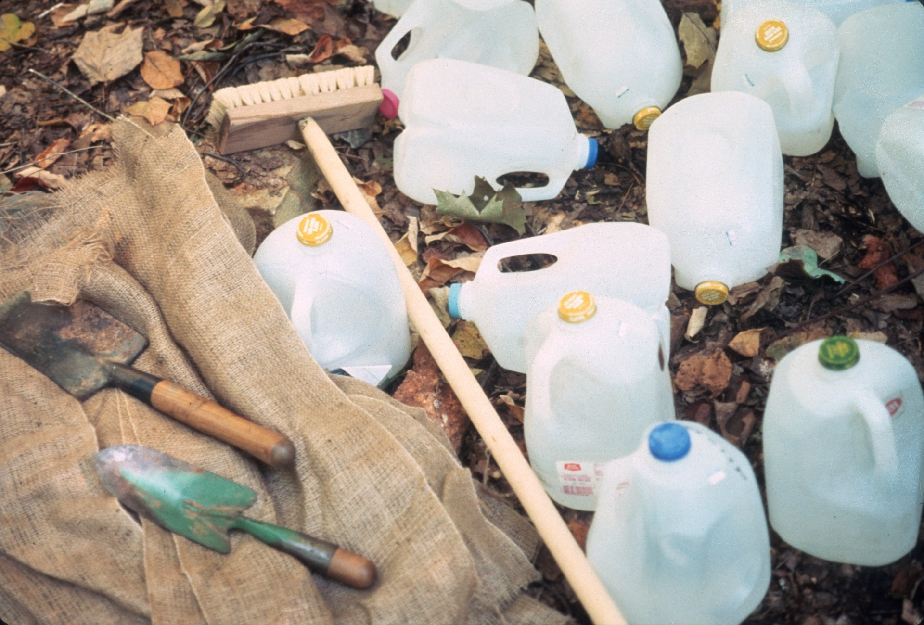
Notes:
There was plenty of water and muriatic acid to wash graffiti off the walls

Slide 15
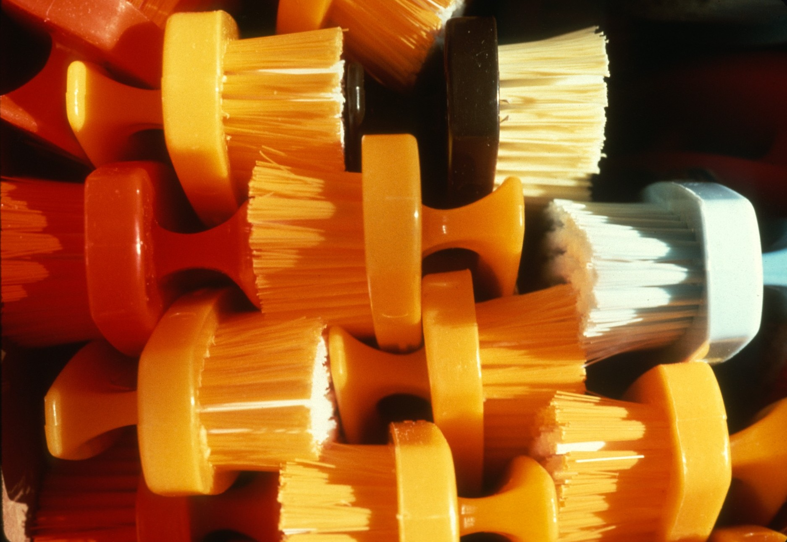
Notes:
… and the necessary scrub brushes.

Slide 16
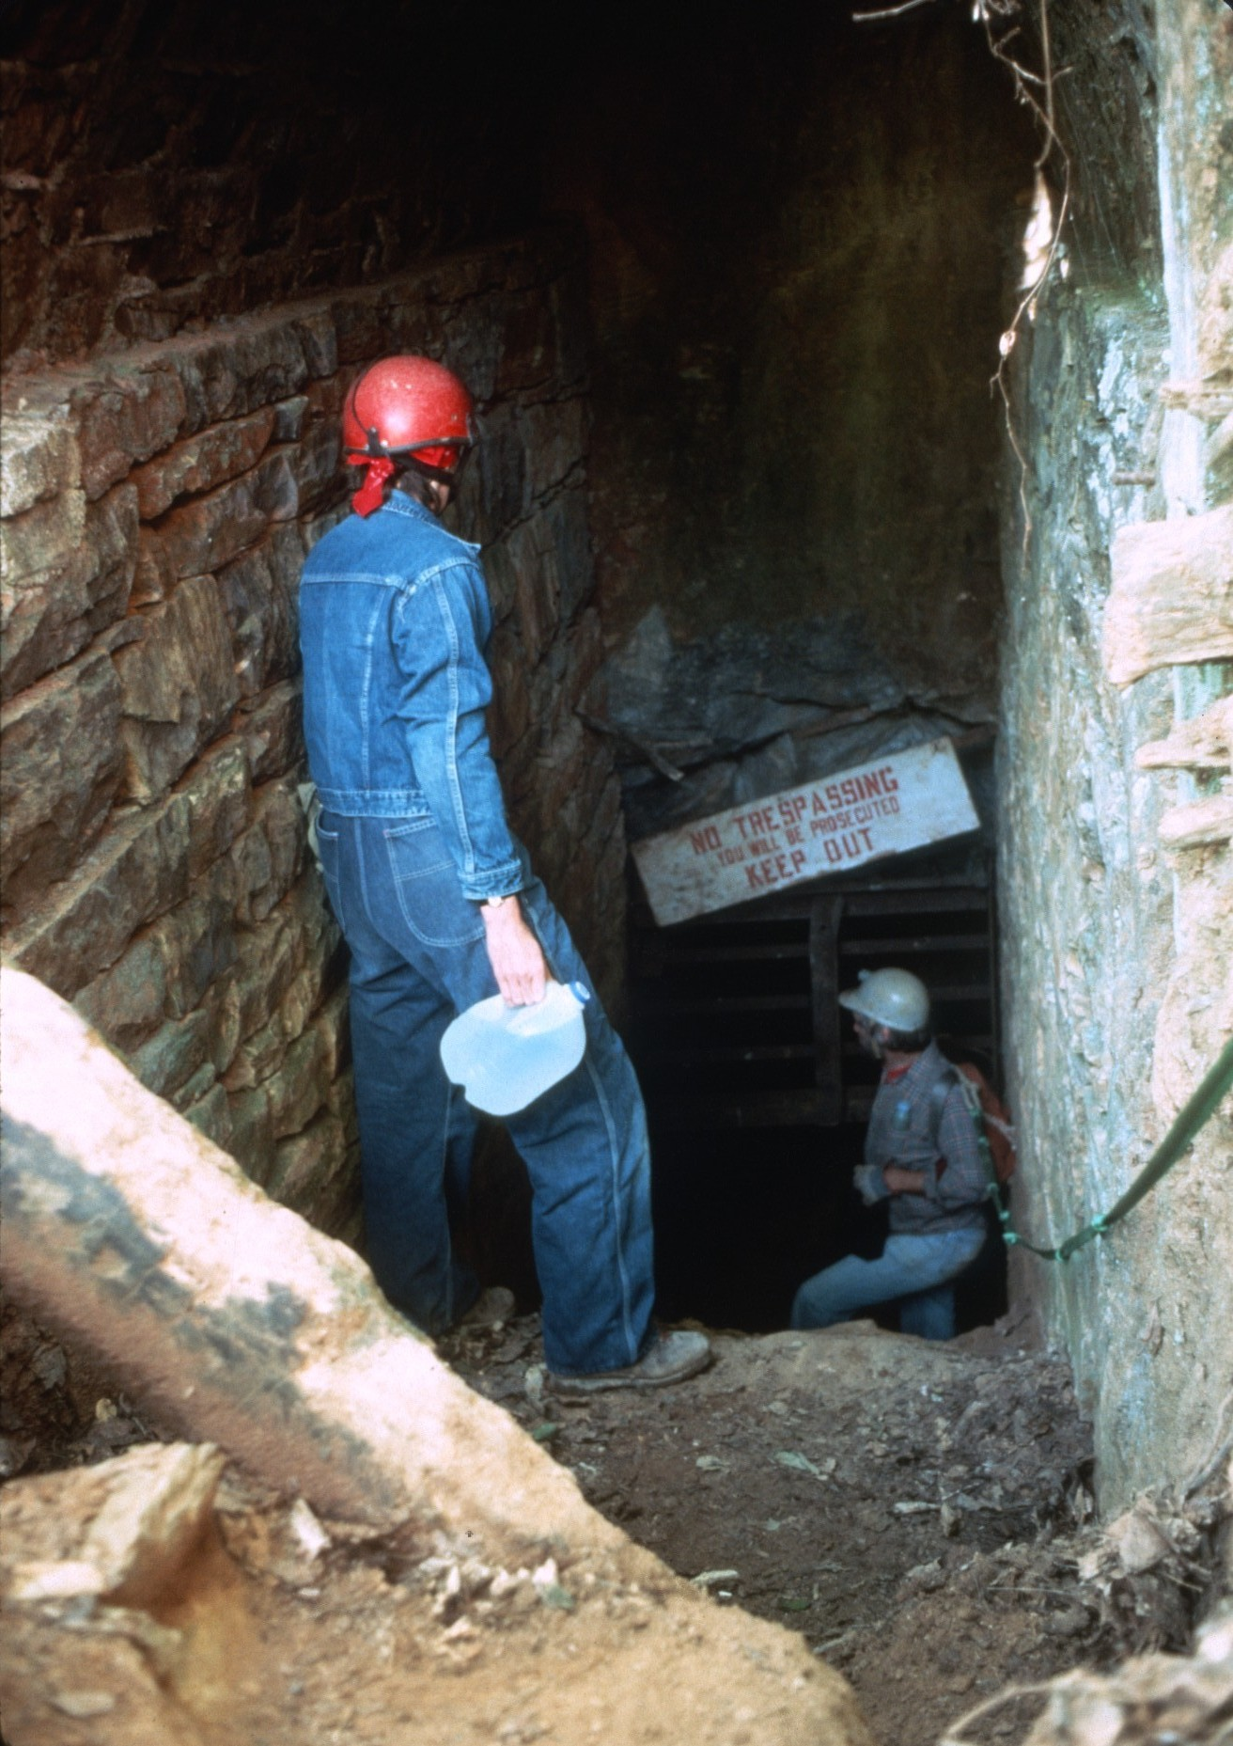
Notes:
As the cavers arrived at the entrance each took a brush and a jug of water and headed into the cave.

Slide 17
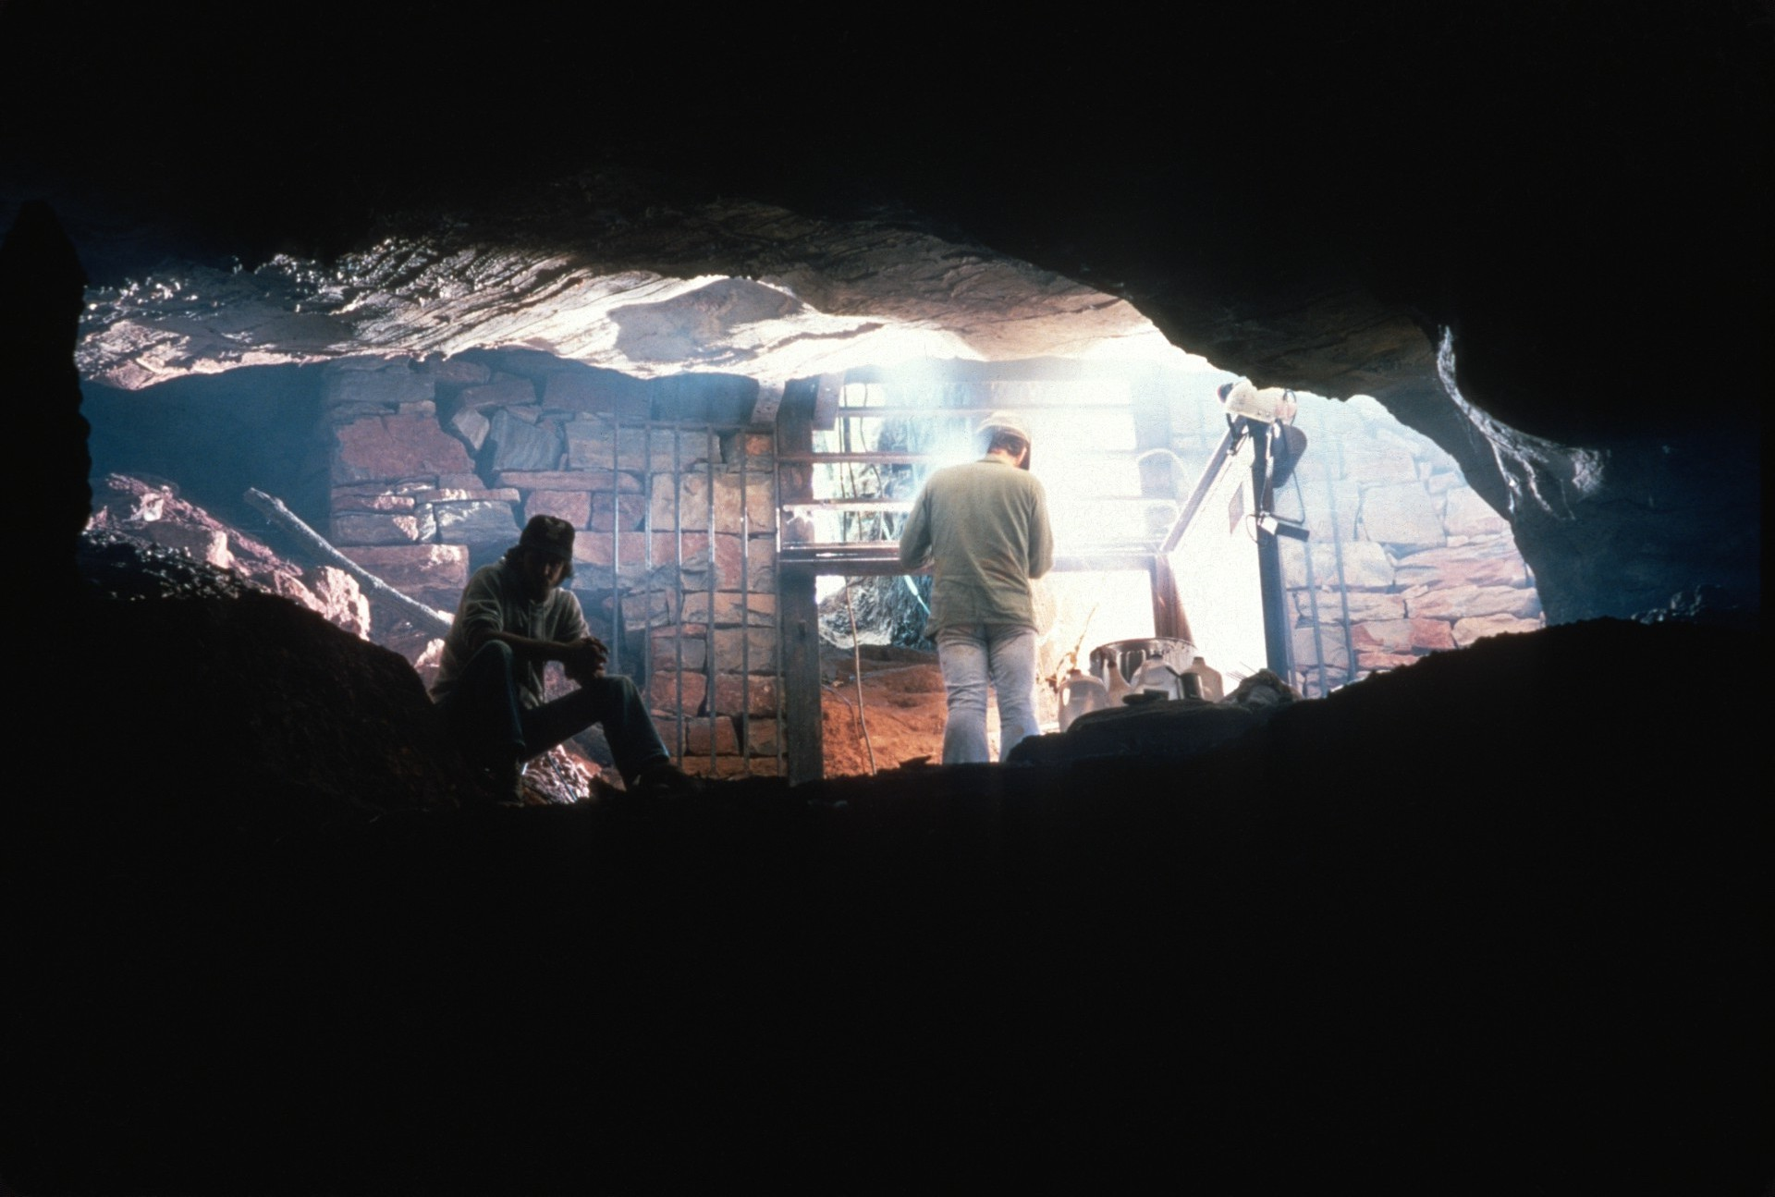
Notes:
At the entrance cavers were busy welding the old gate to repair the damage done by vandals.

Slide 18
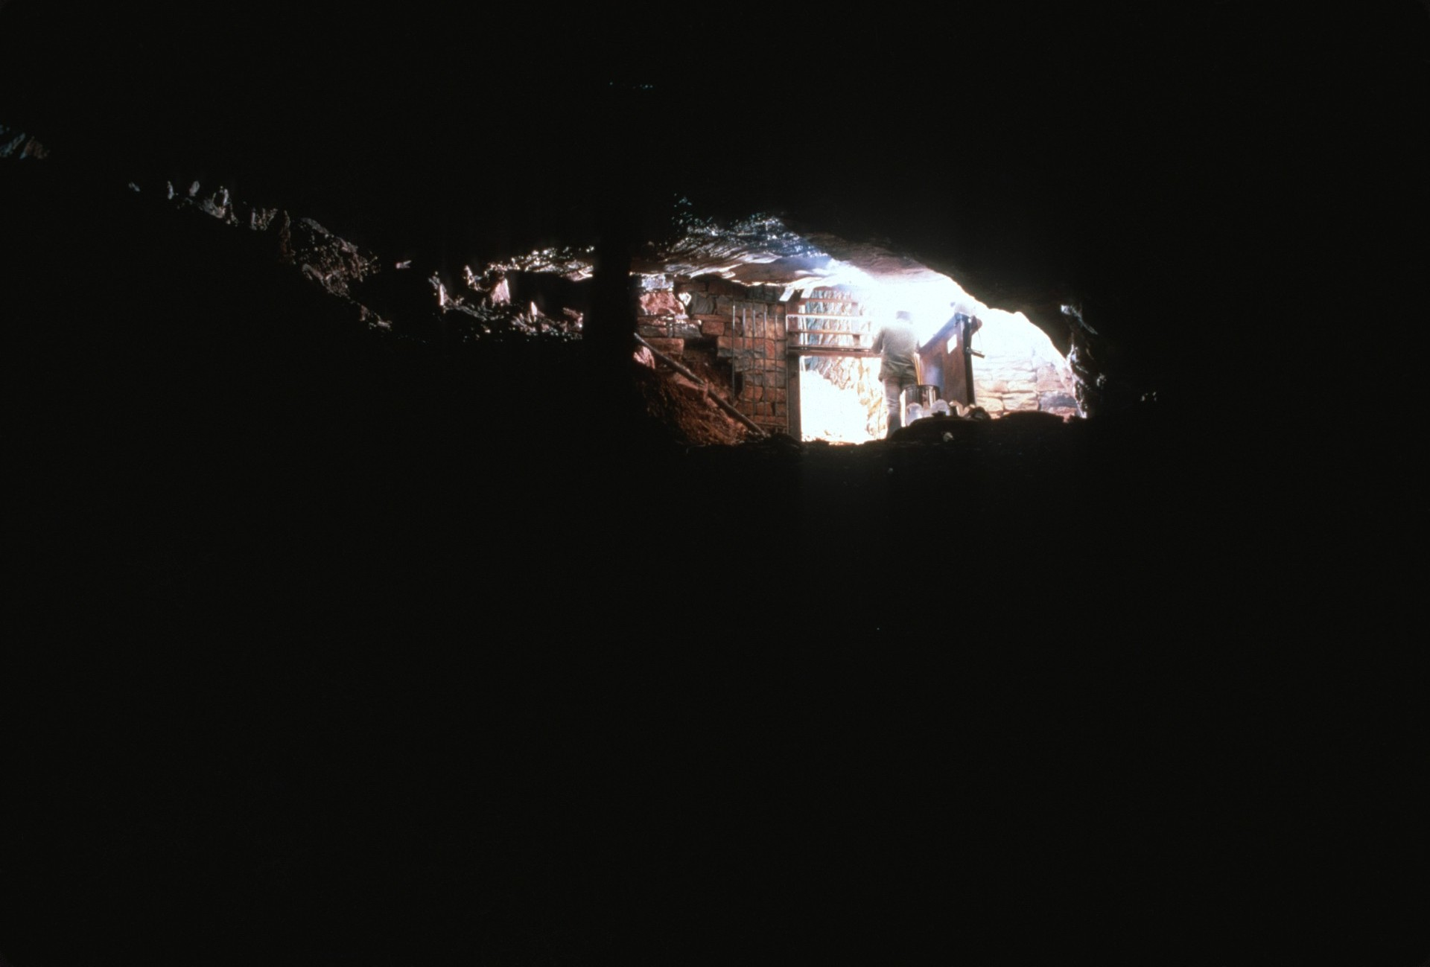

Slide 19
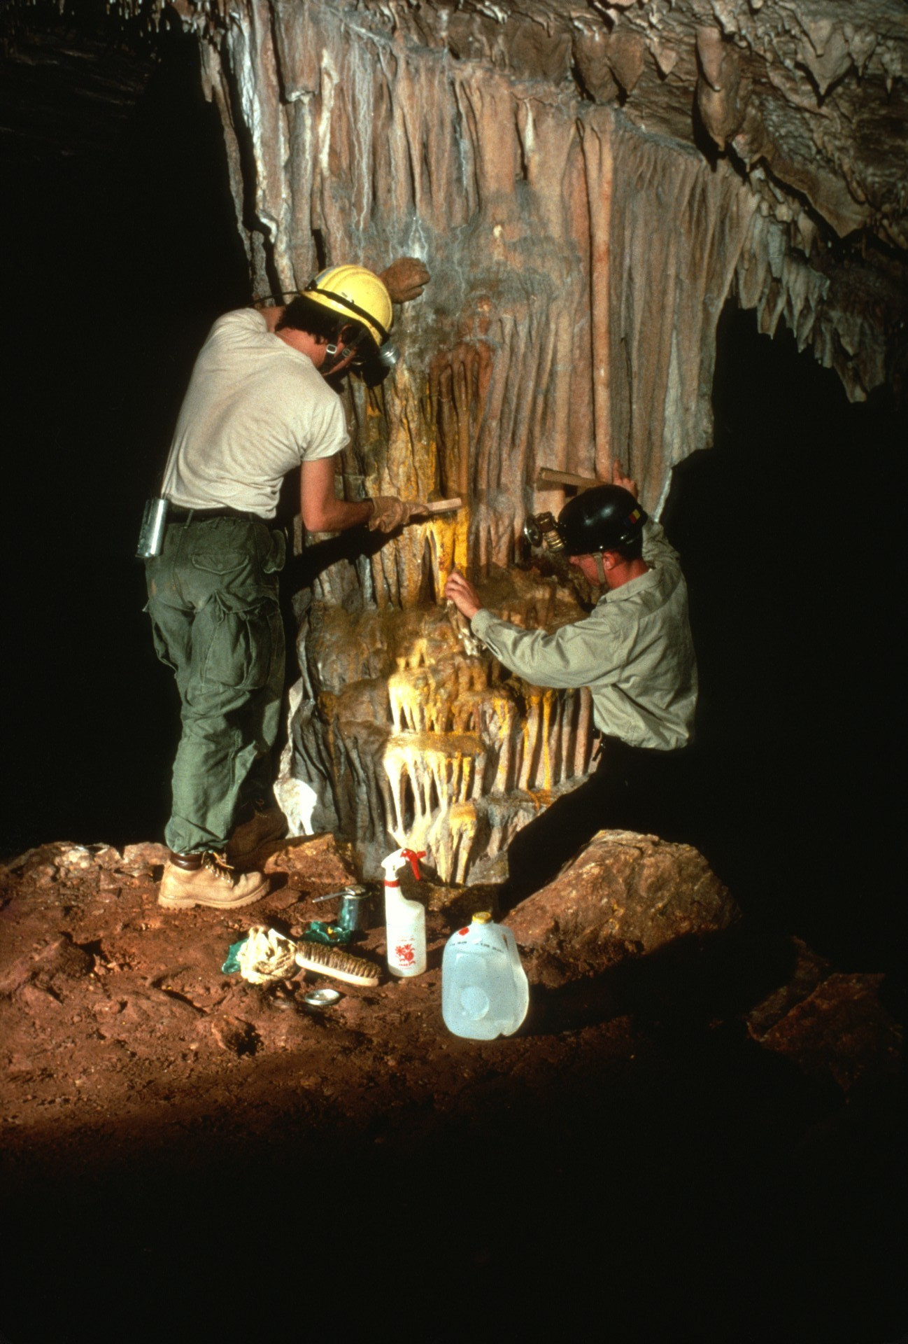
Notes:
Farther into the cave someone had thrown yellow paint at a formation and now it was our task to get it off.

Slide 20
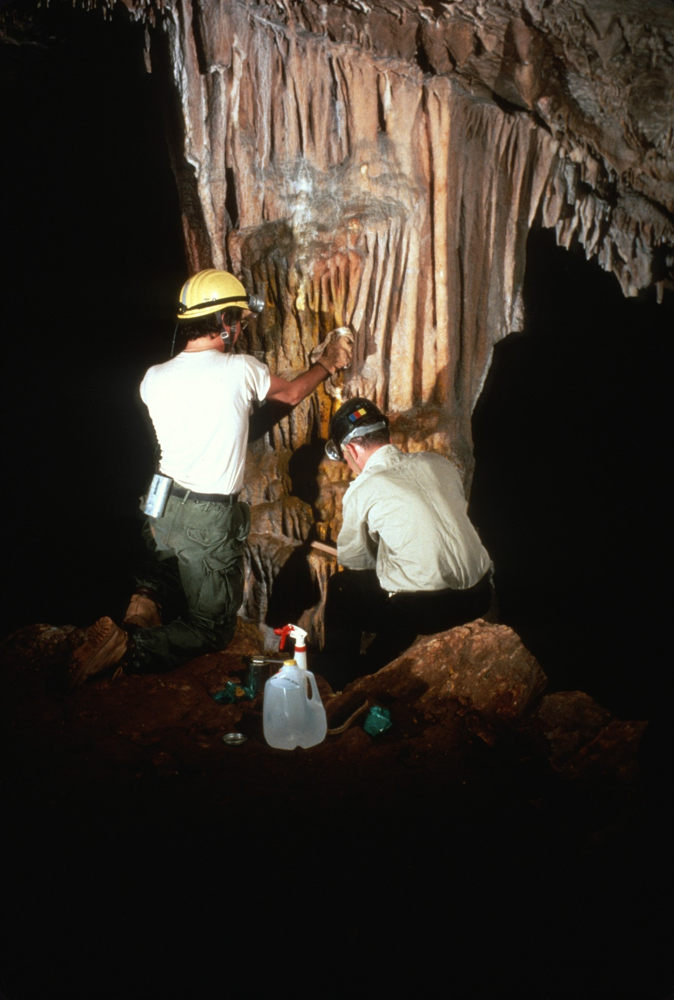

Slide 21
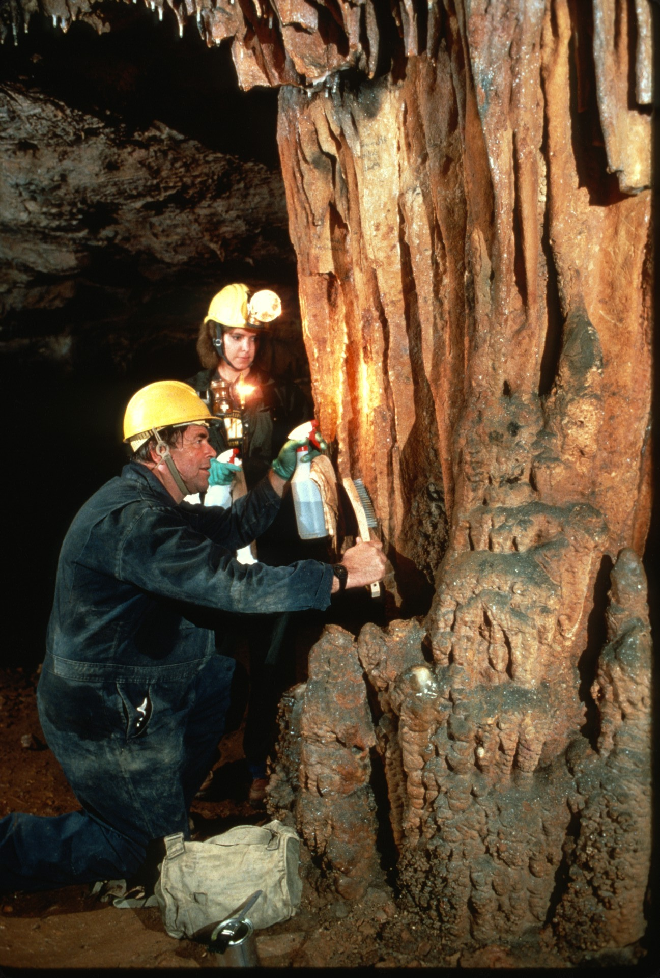

Slide 22
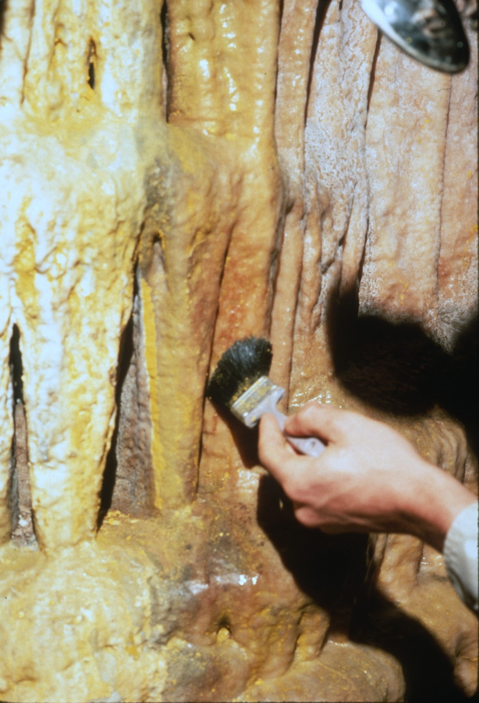

Slide 23
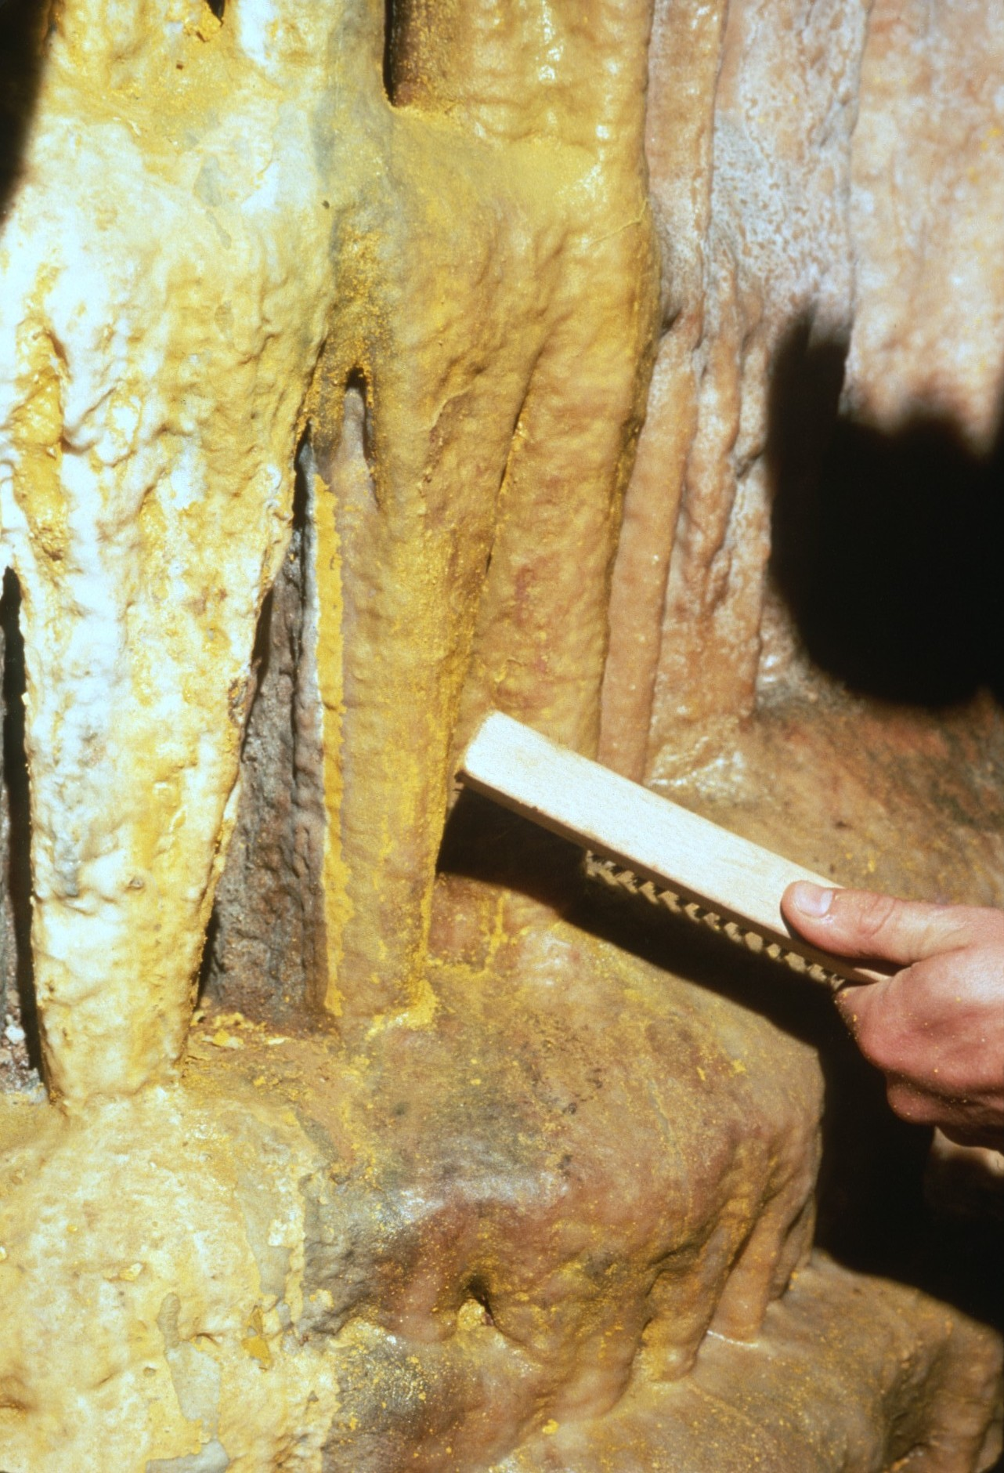
Notes:
Paint remover and a lot of wire brushing…

Slide 24
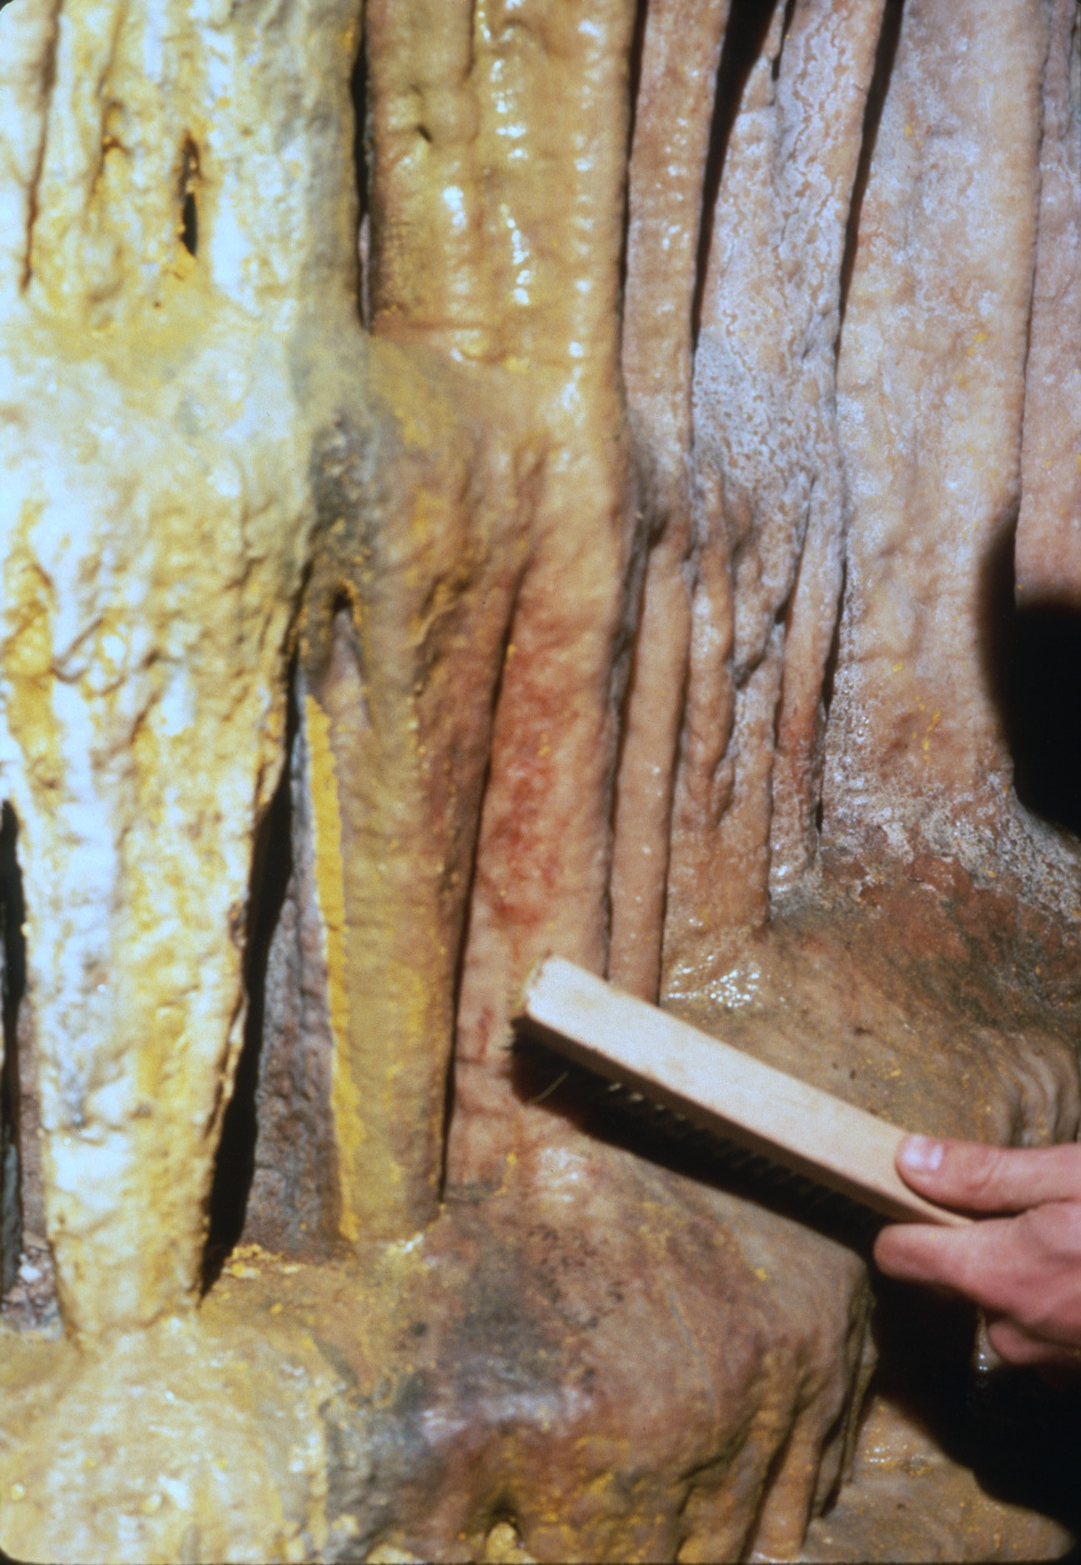
Notes:
…eventually restored the original color.

Slide 25
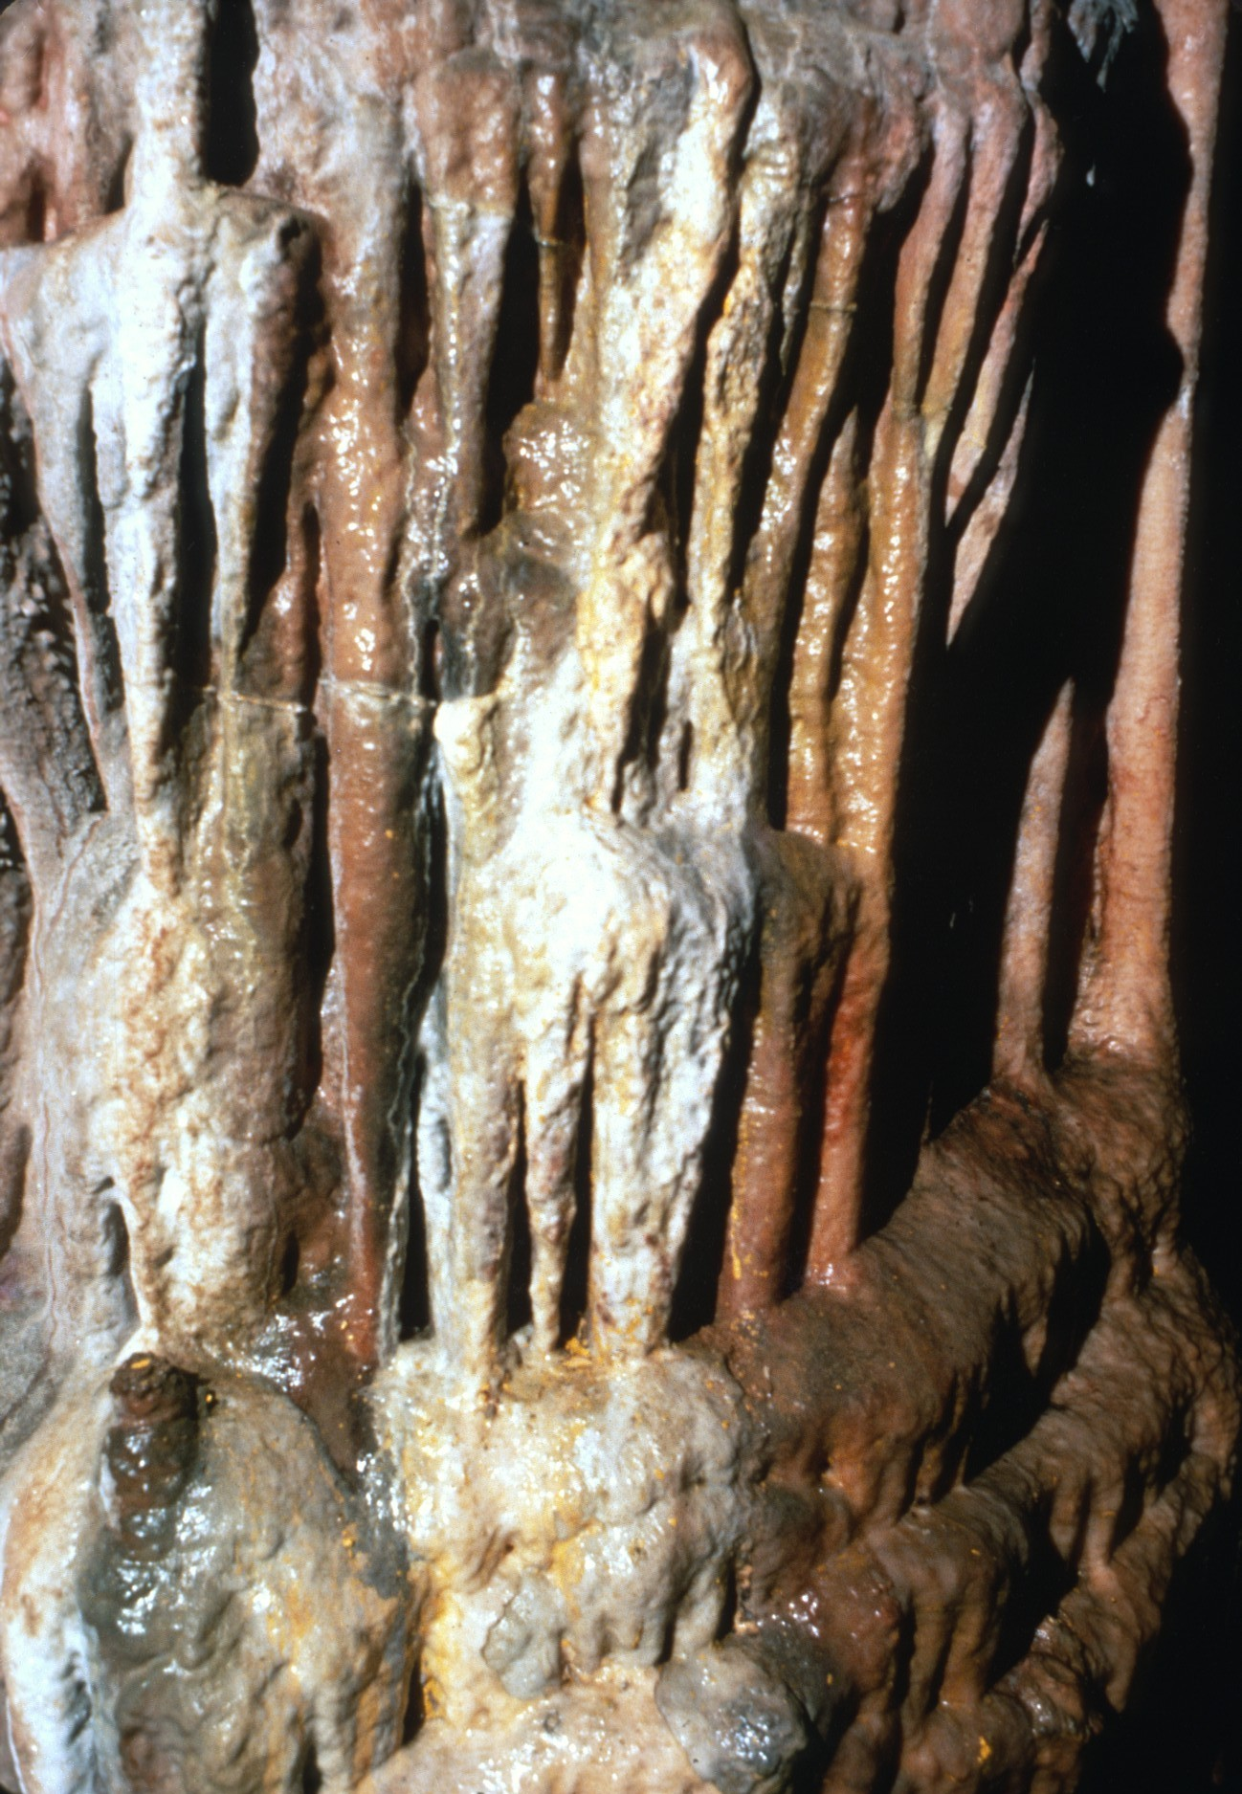

Slide 26
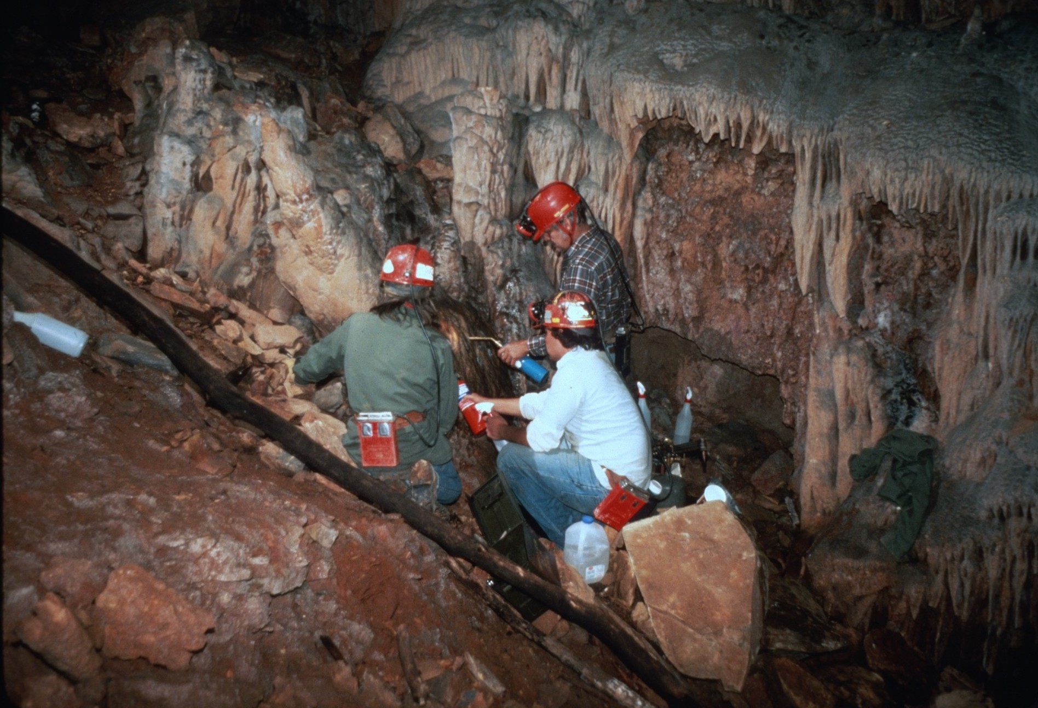
Notes:
On another formation the paint wouldn’t come off with paint remover so a welding torch was used to burn it off.

Slide 27
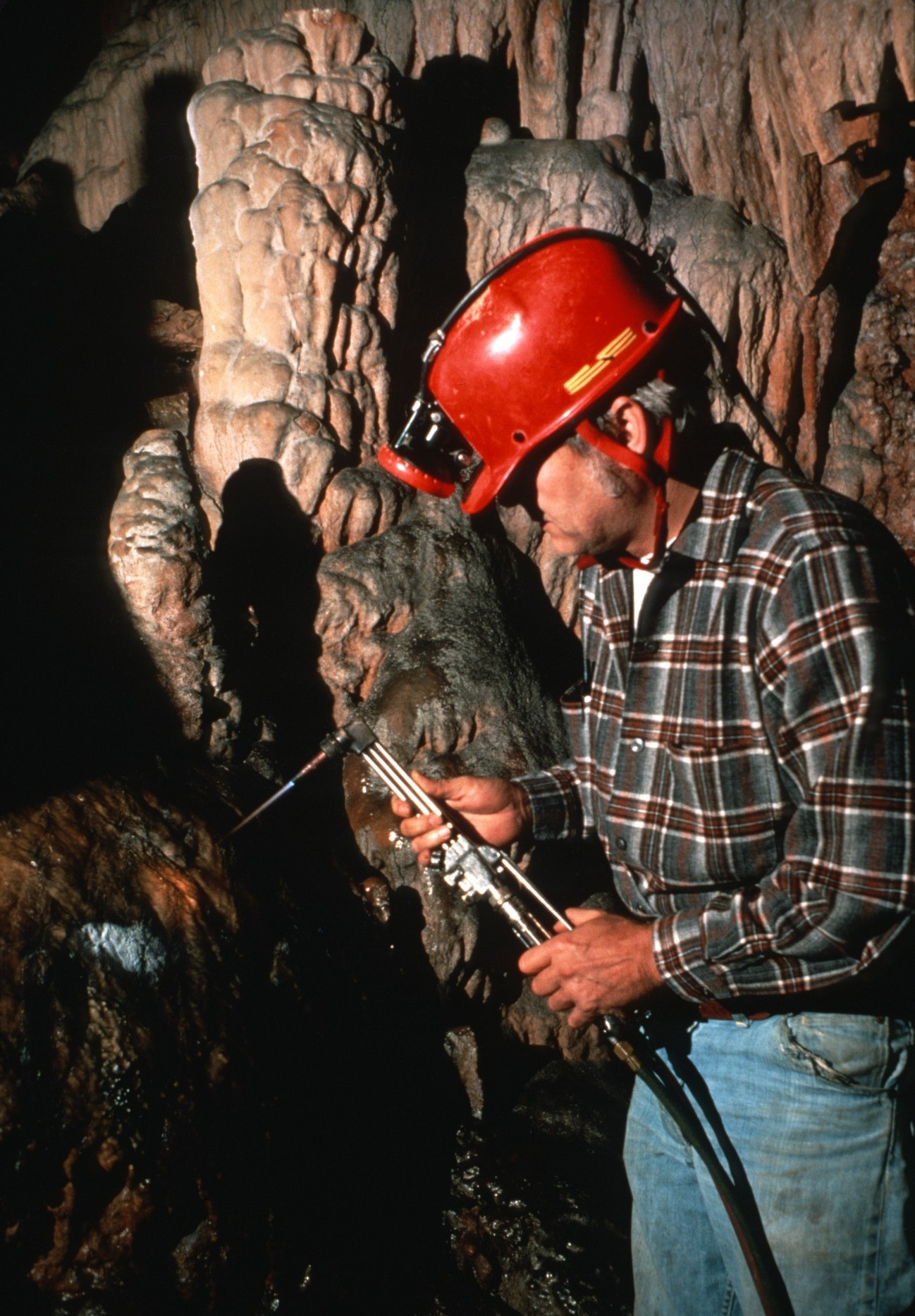

Slide 28
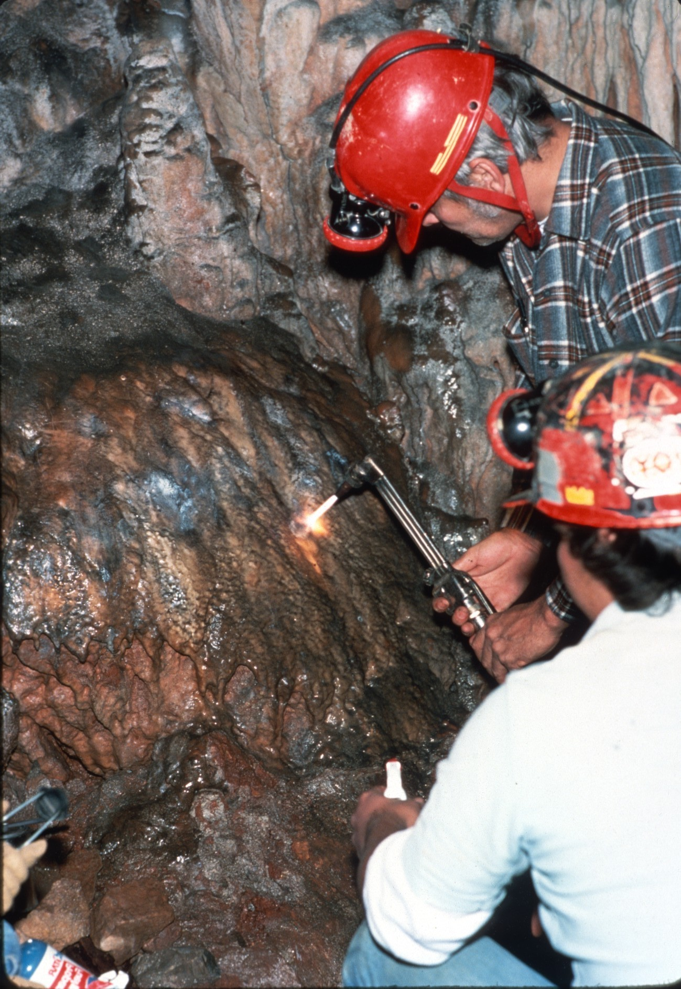

Slide 29
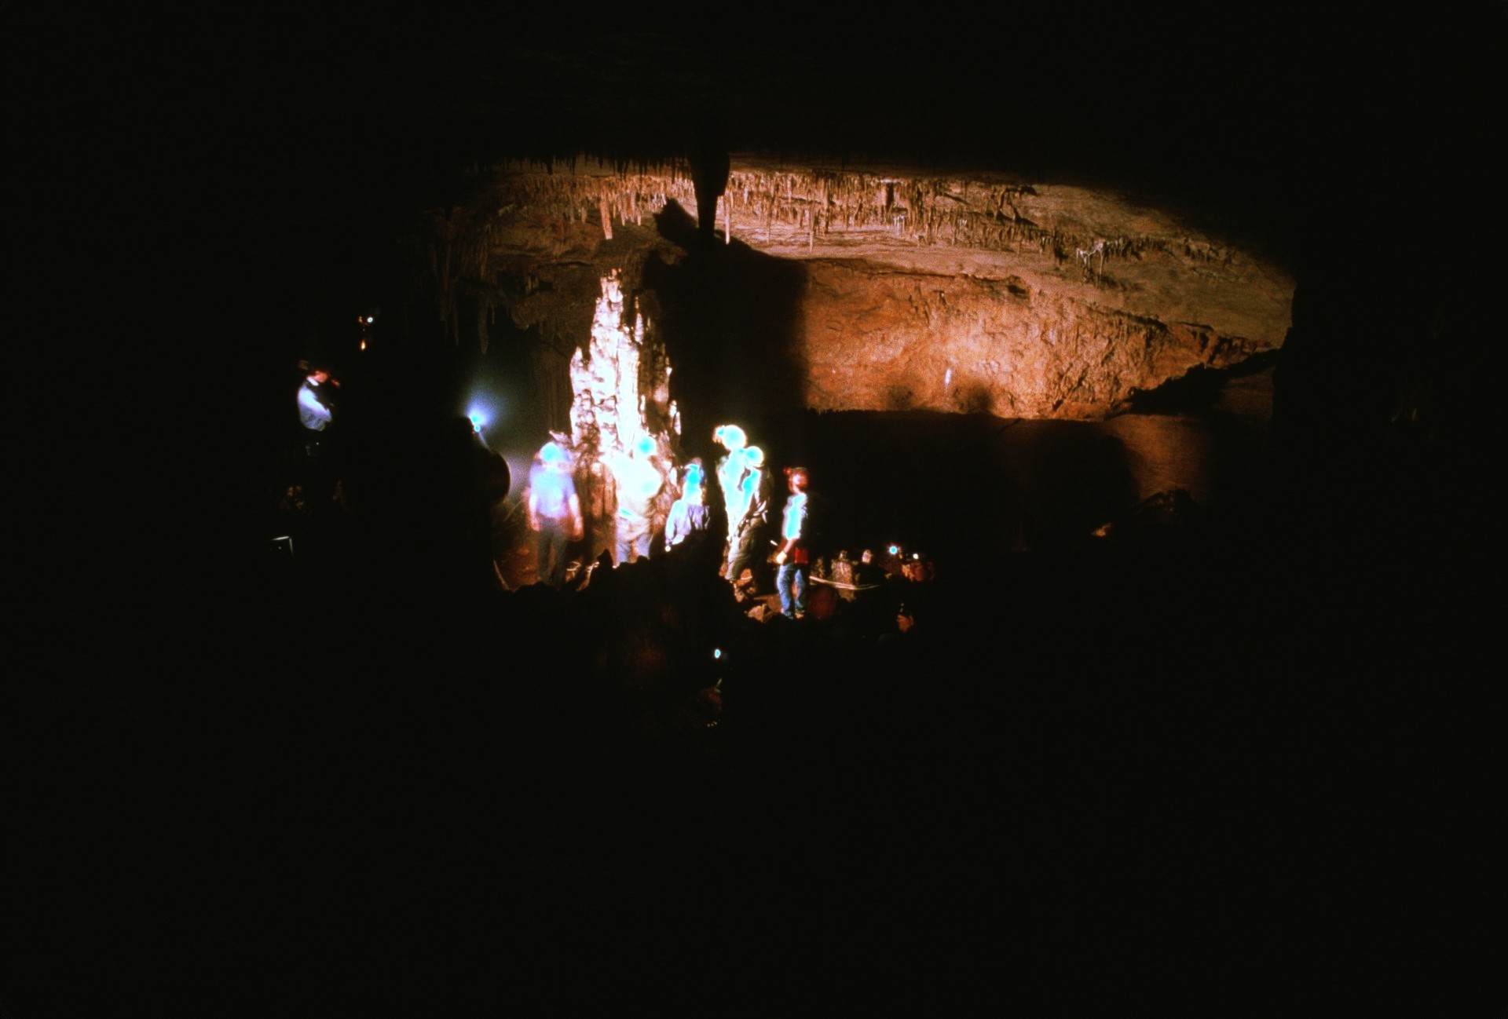

Slide 30
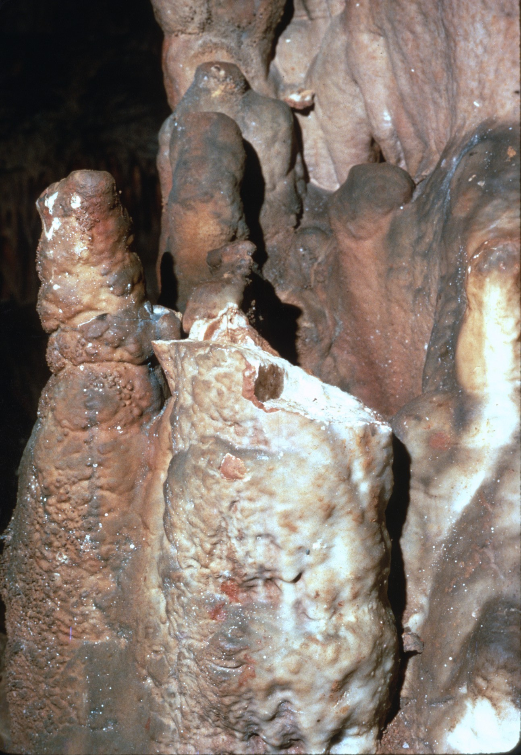
Notes:
Deeper in the cave was a section of broken stalagmites.

Slide 31
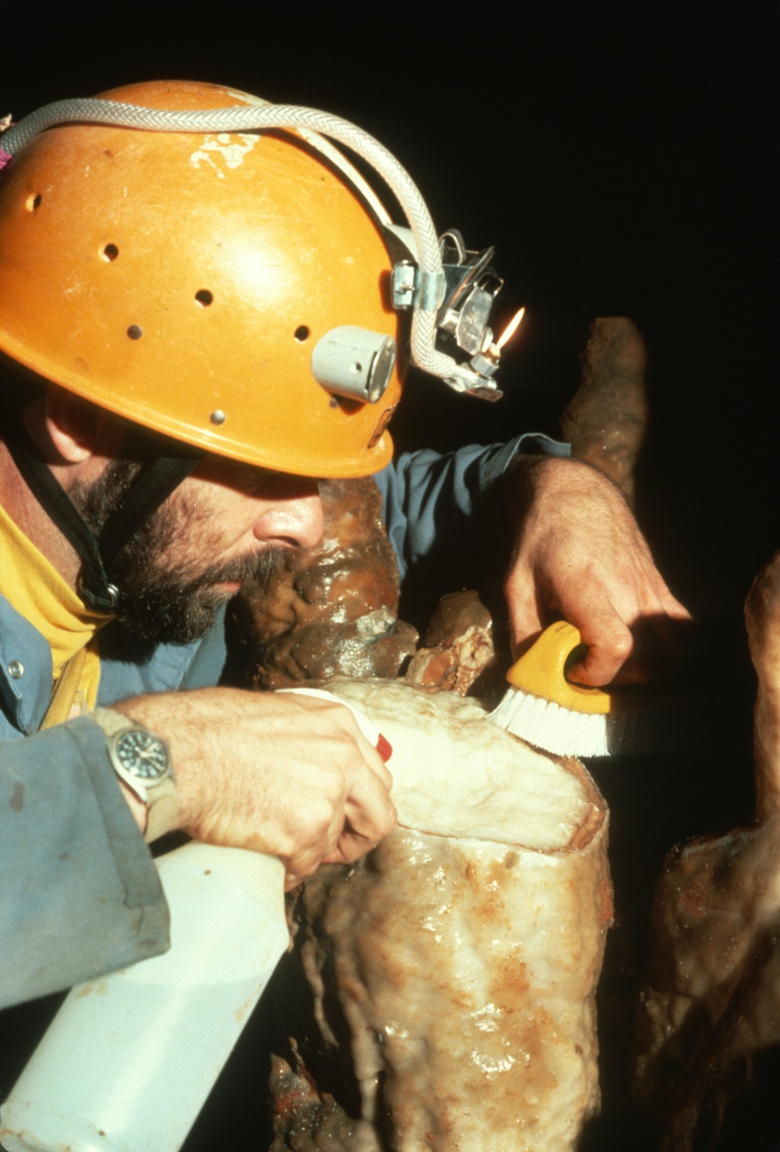
Notes:
After cleaning the top of one…

Slide 32
Notes:
…quick setting cement was applied.

Slide 33
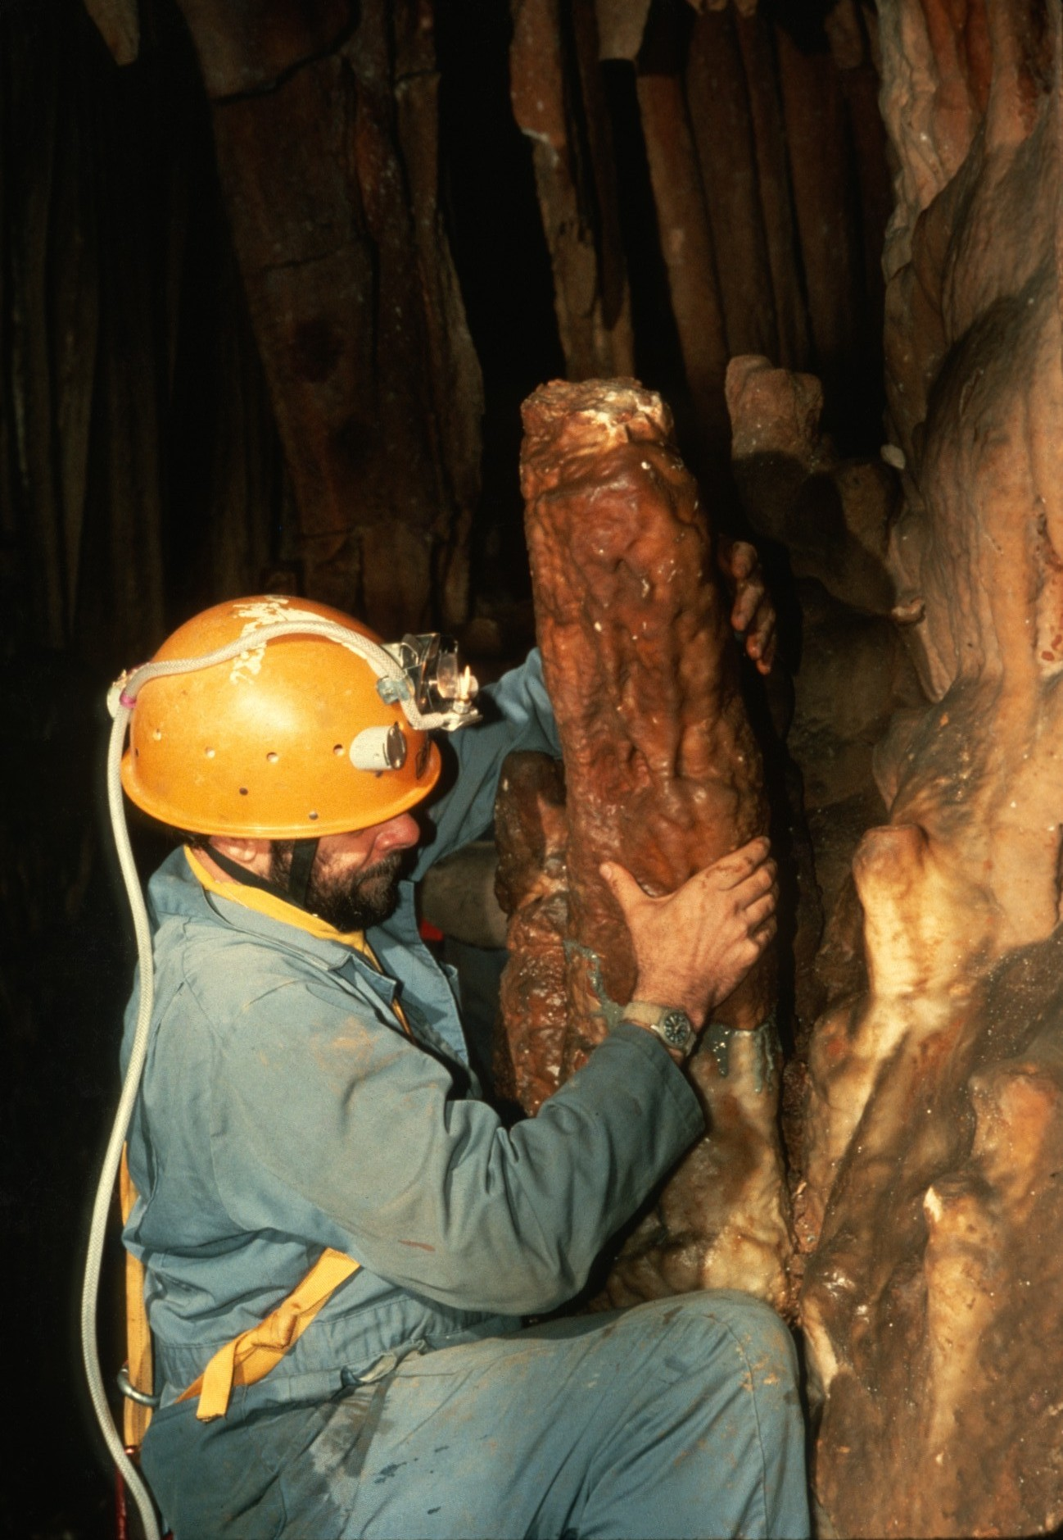
Notes:
The broken part of the formation was returned to its original position and…

Slide 34
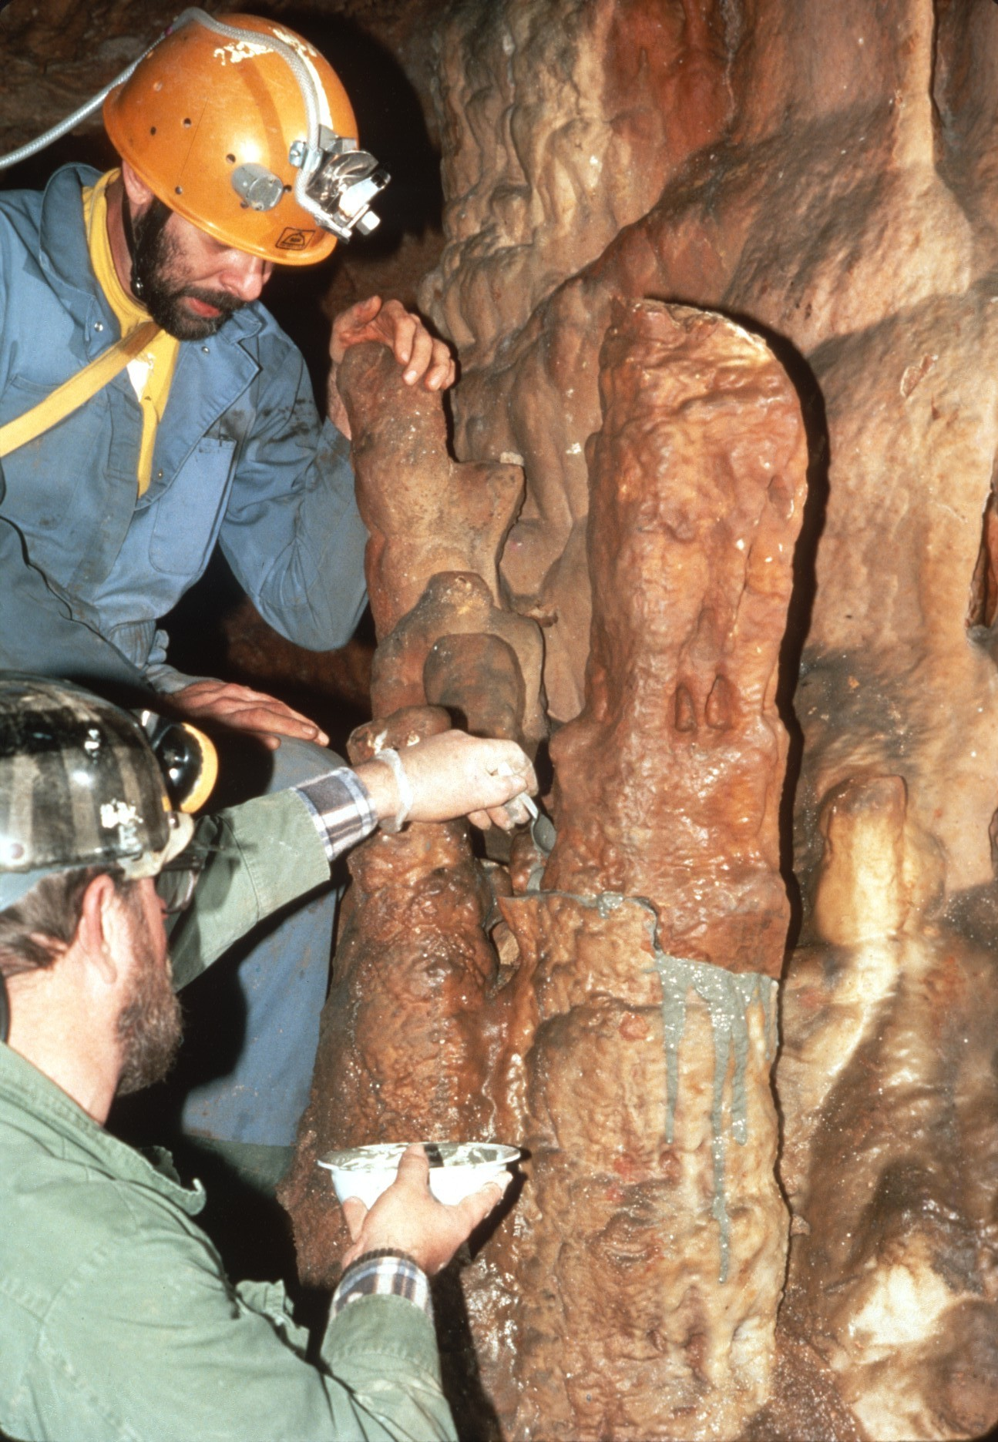
Notes:
…more cement was applied.

Slide 35
Notes:
When it was all done…

Slide 36
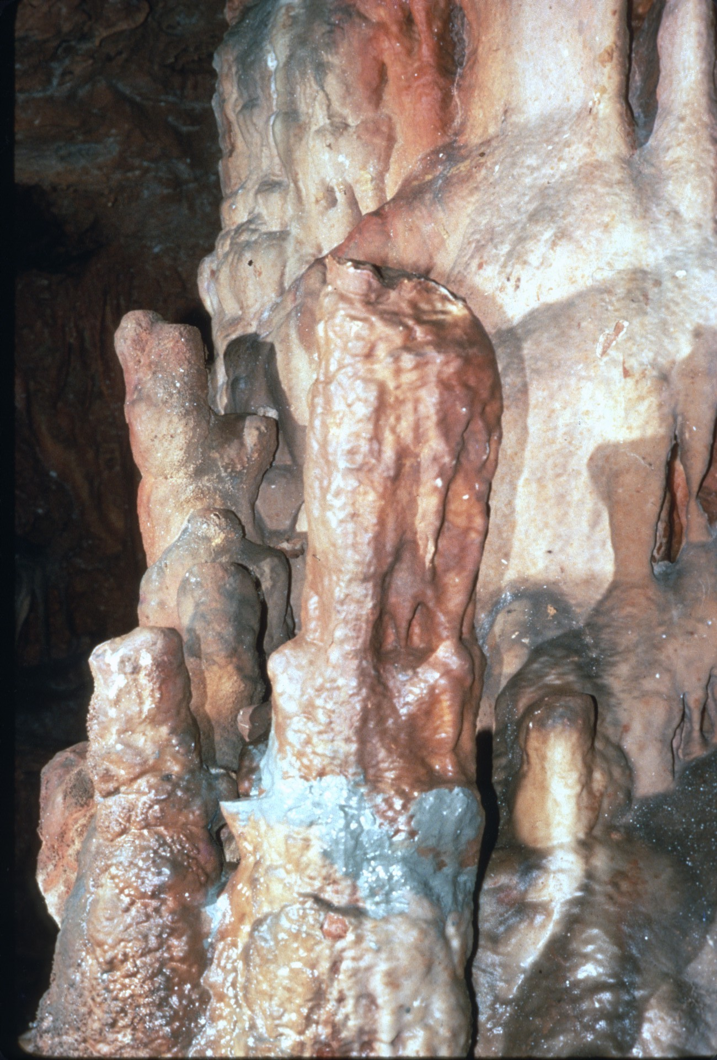
Notes:
…the formation was almost as good as new. The process was repeated on other broken formations in the area.

Slide 37
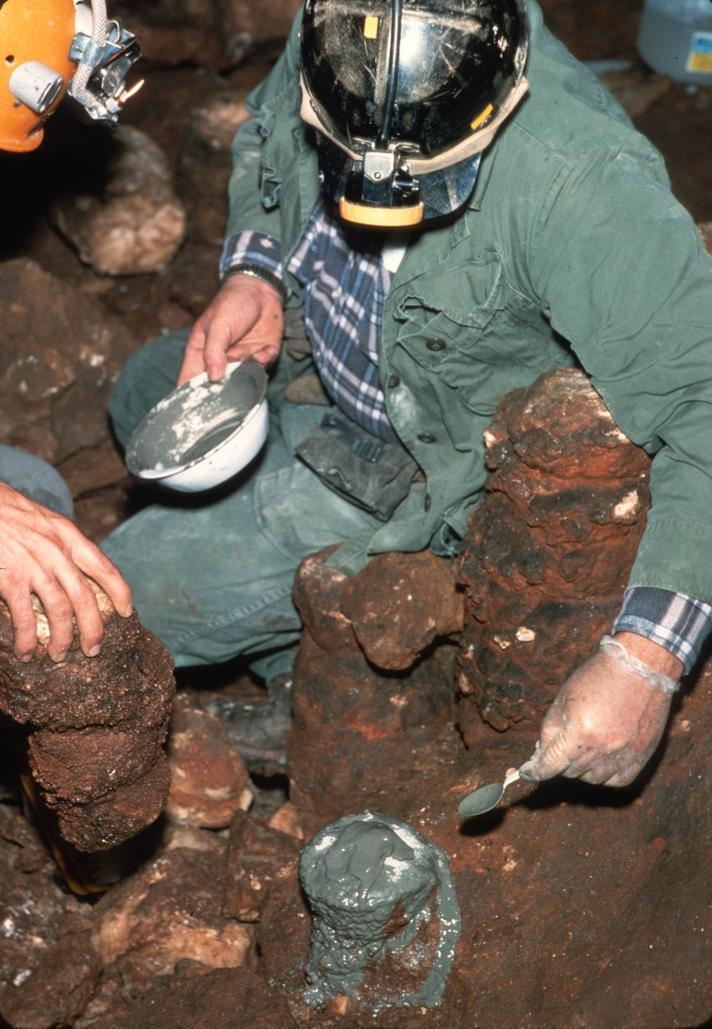

Slide 38
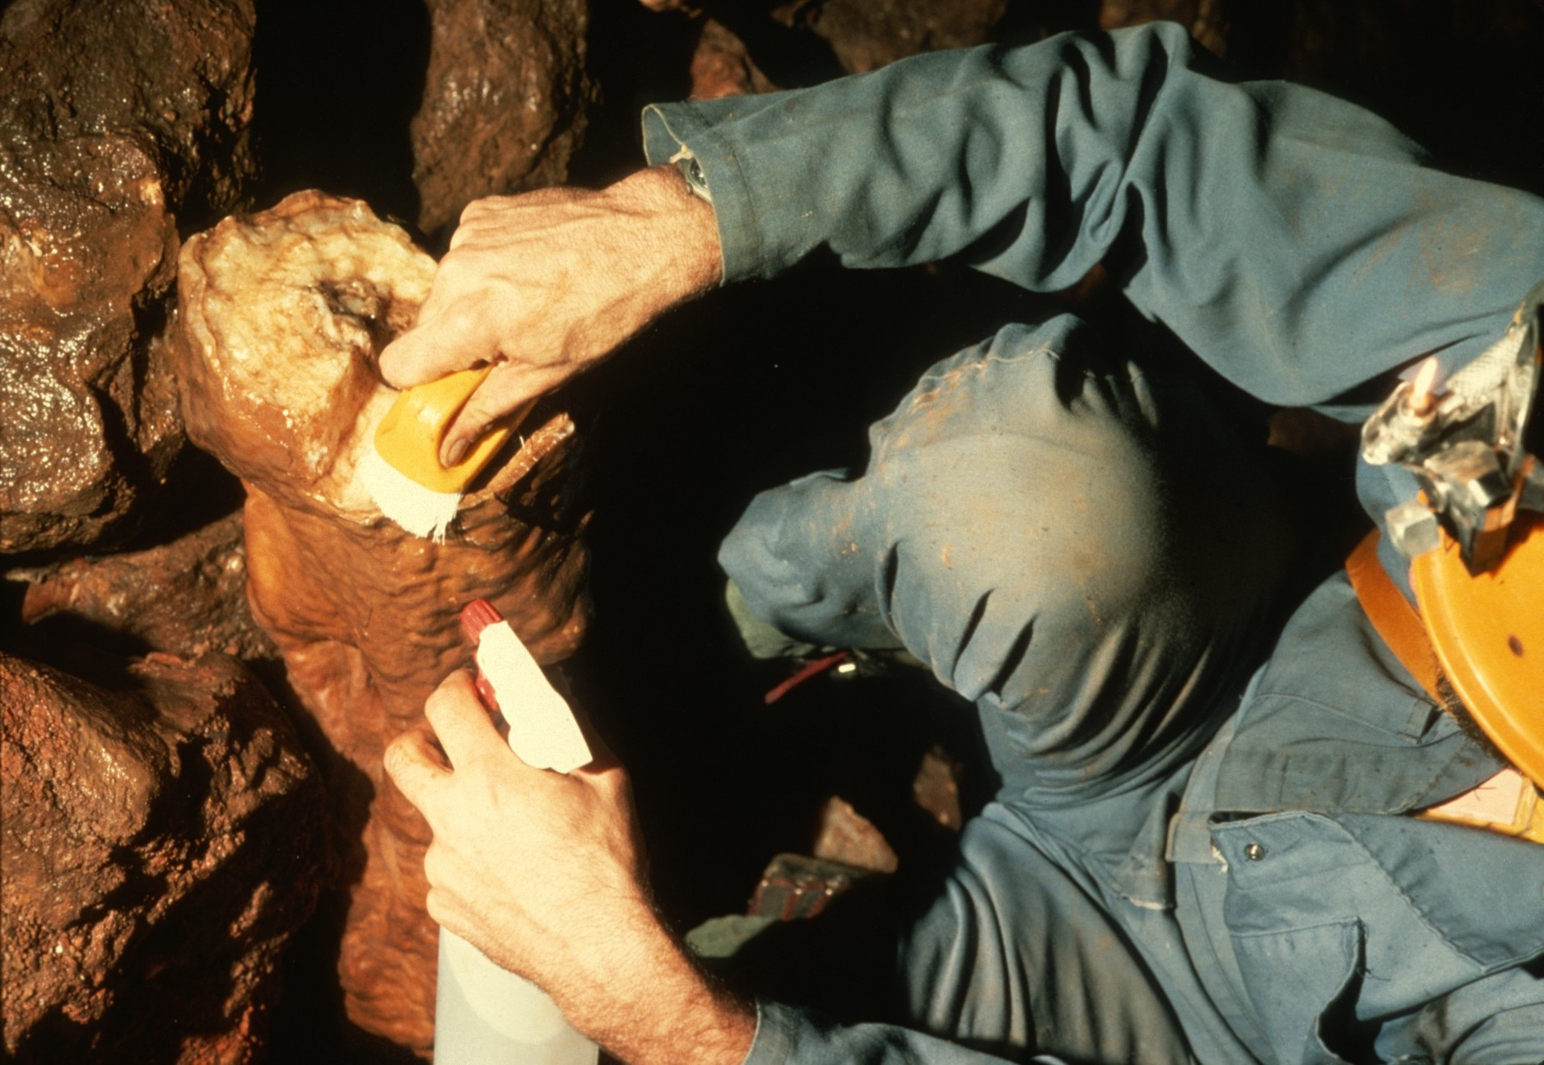

Slide 39
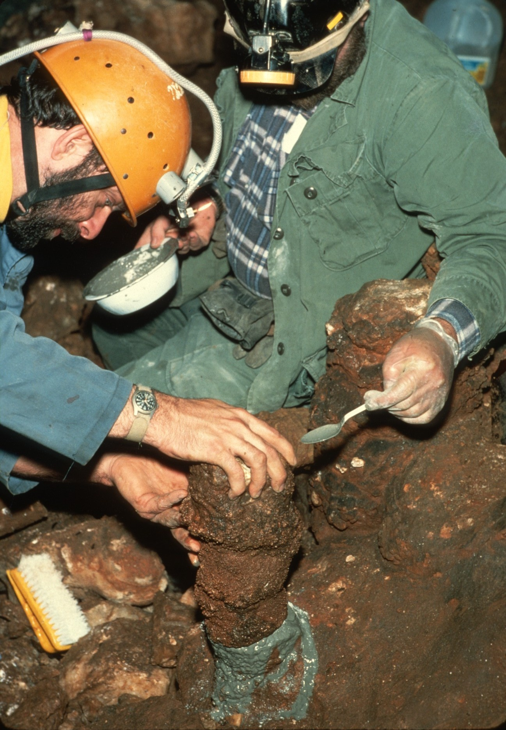

Slide 41
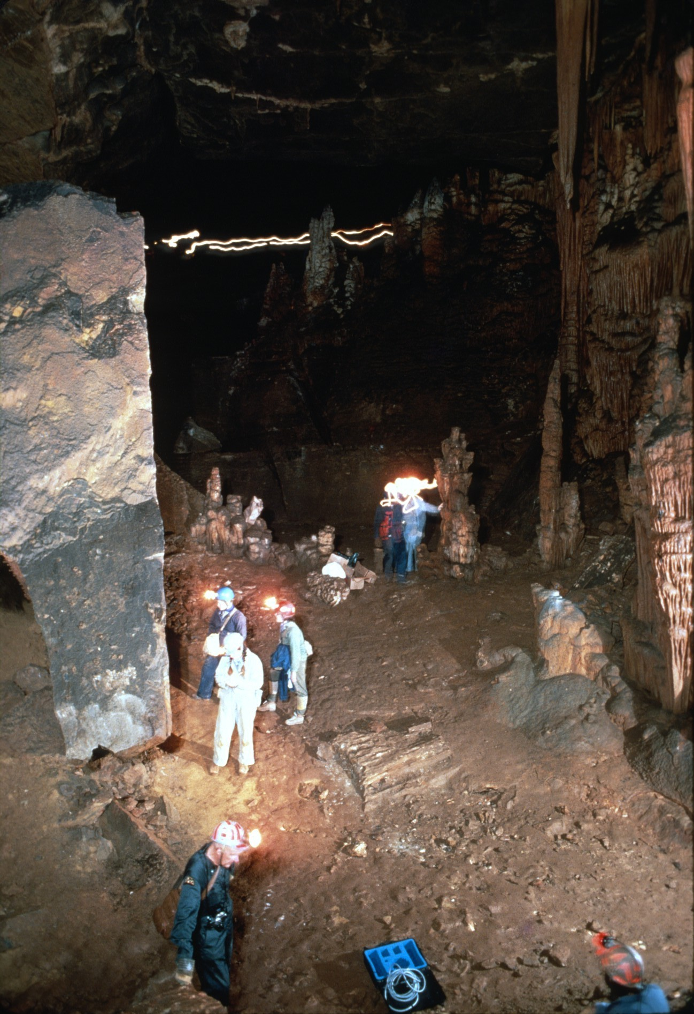
Notes:
The cave was filled with cavers cleaning writing from the walls.

Slide 42
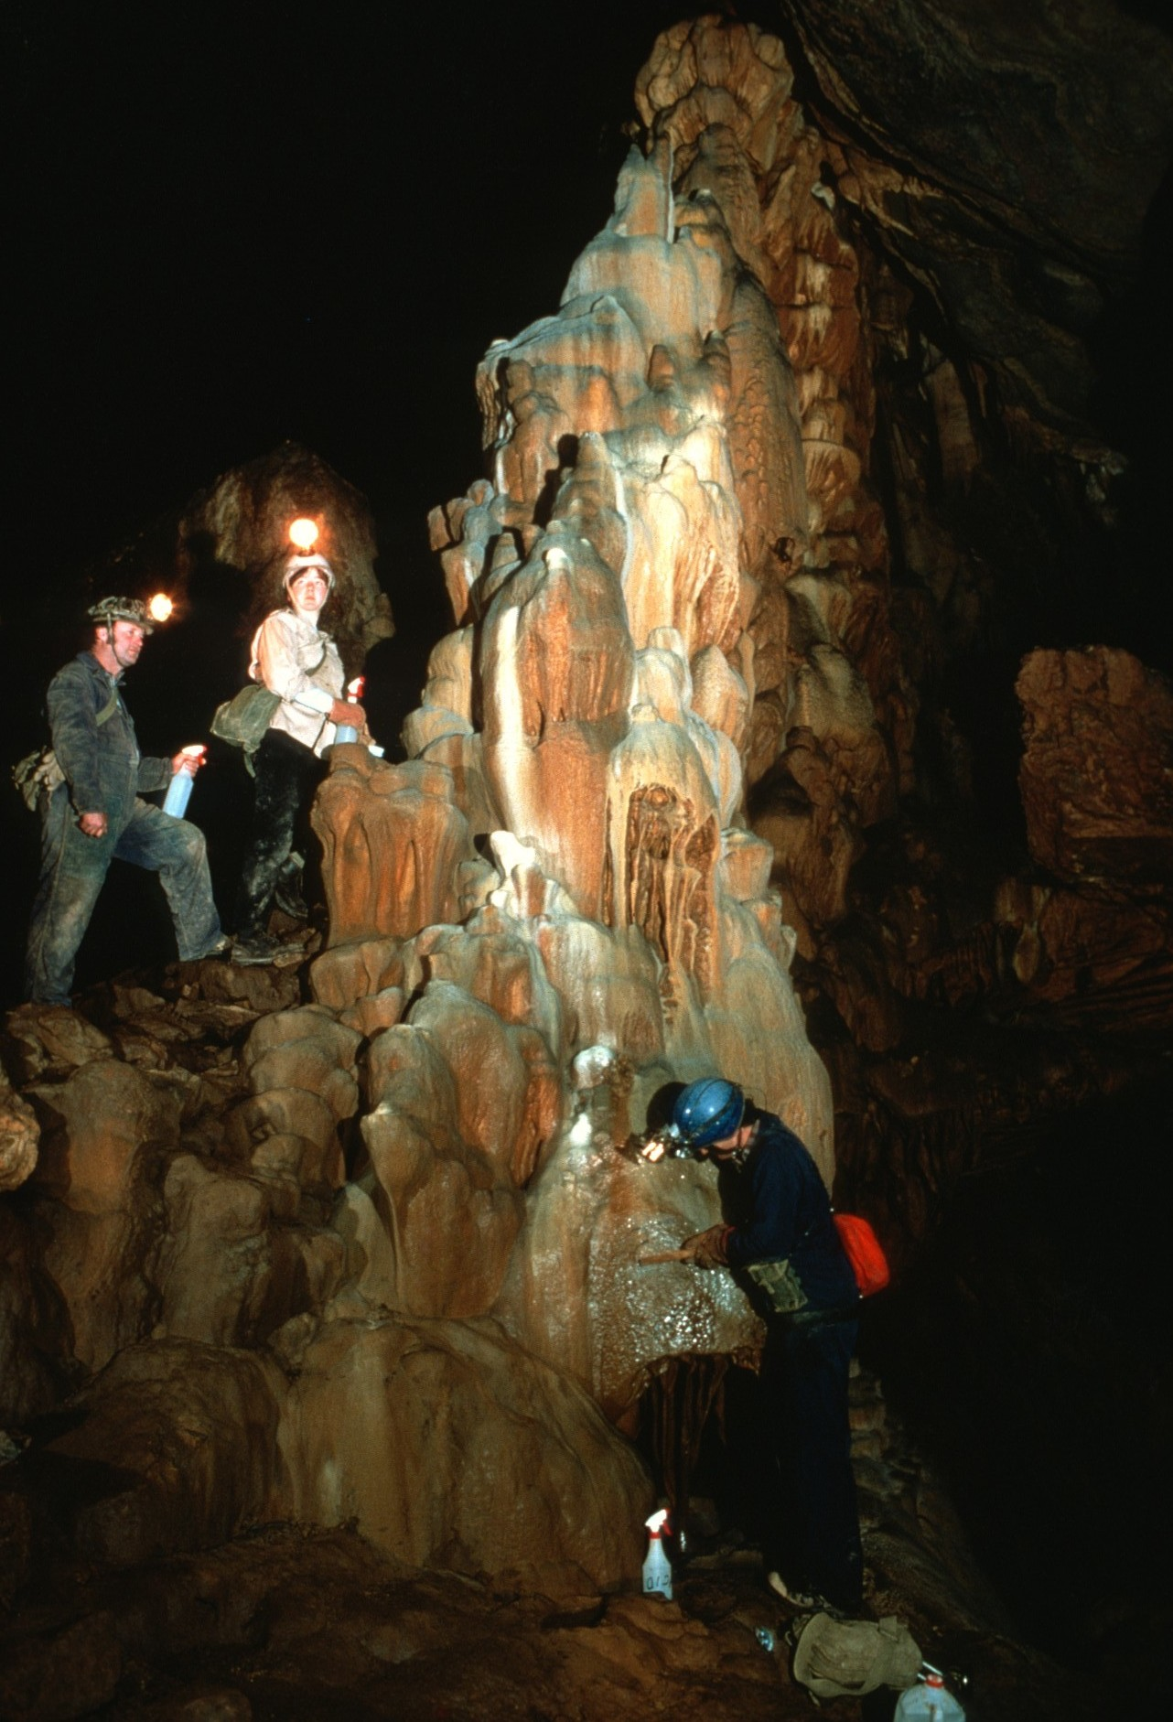

Slide 43
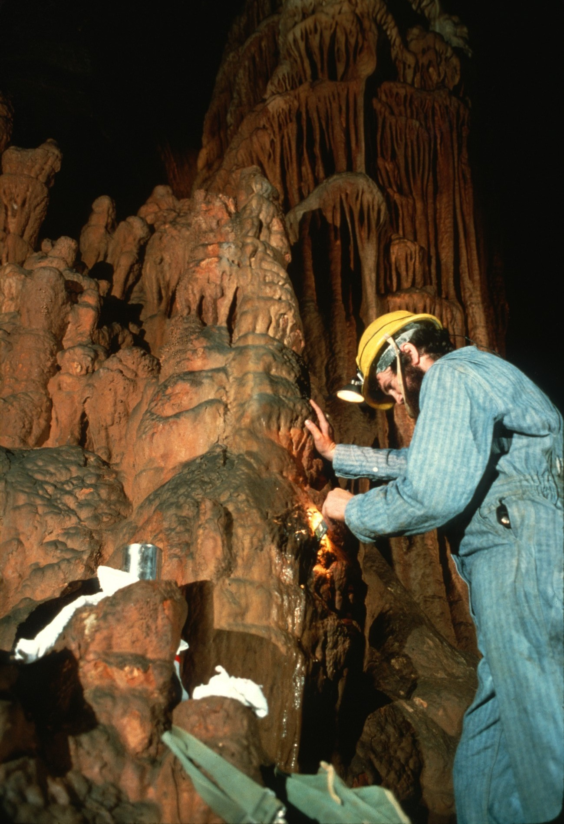

Slide 44
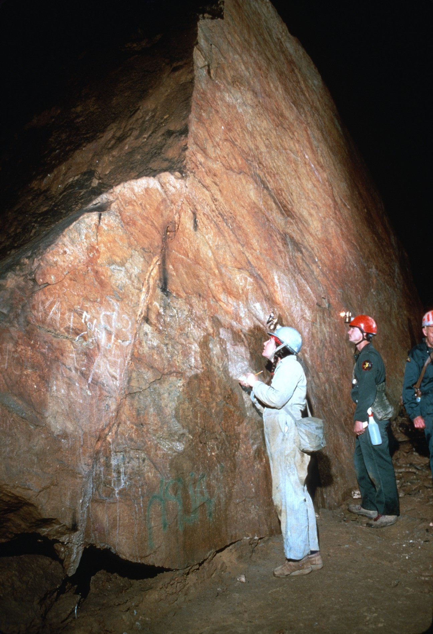
Notes:
When the writing was thought to be of historical significance, it was copied…

Slide 45
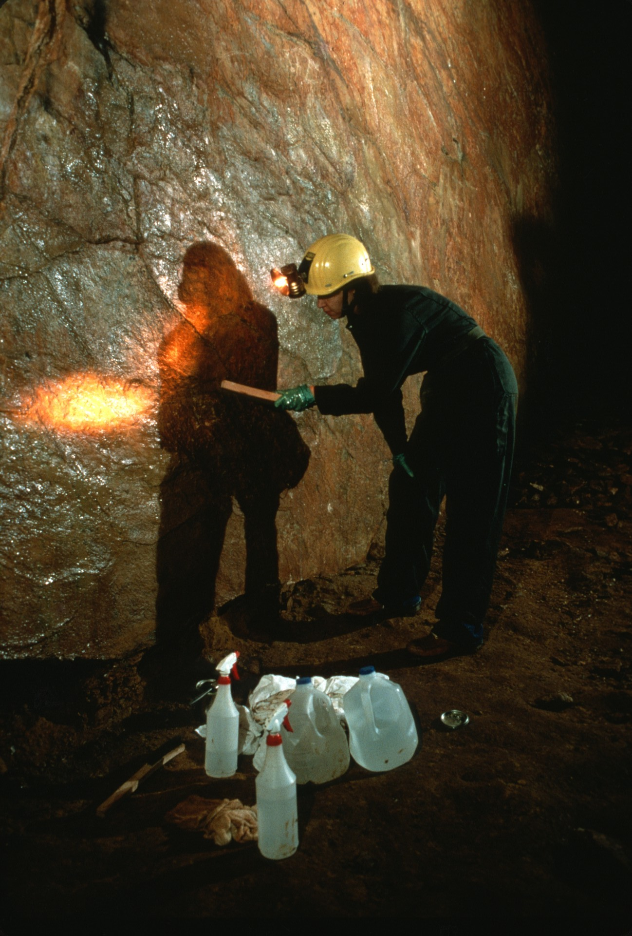
Notes:
…before being removed.

Slide 46
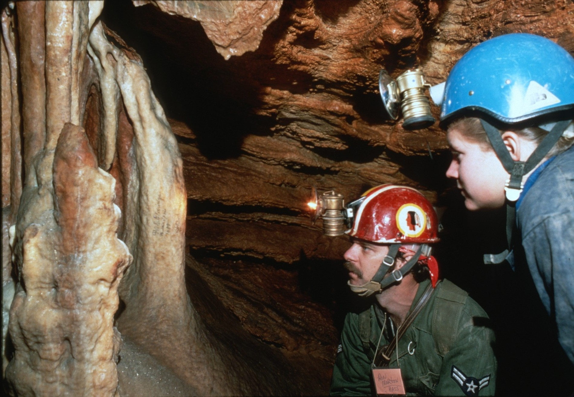
Notes:
The cave was filled with historic signatures.

Slide 47
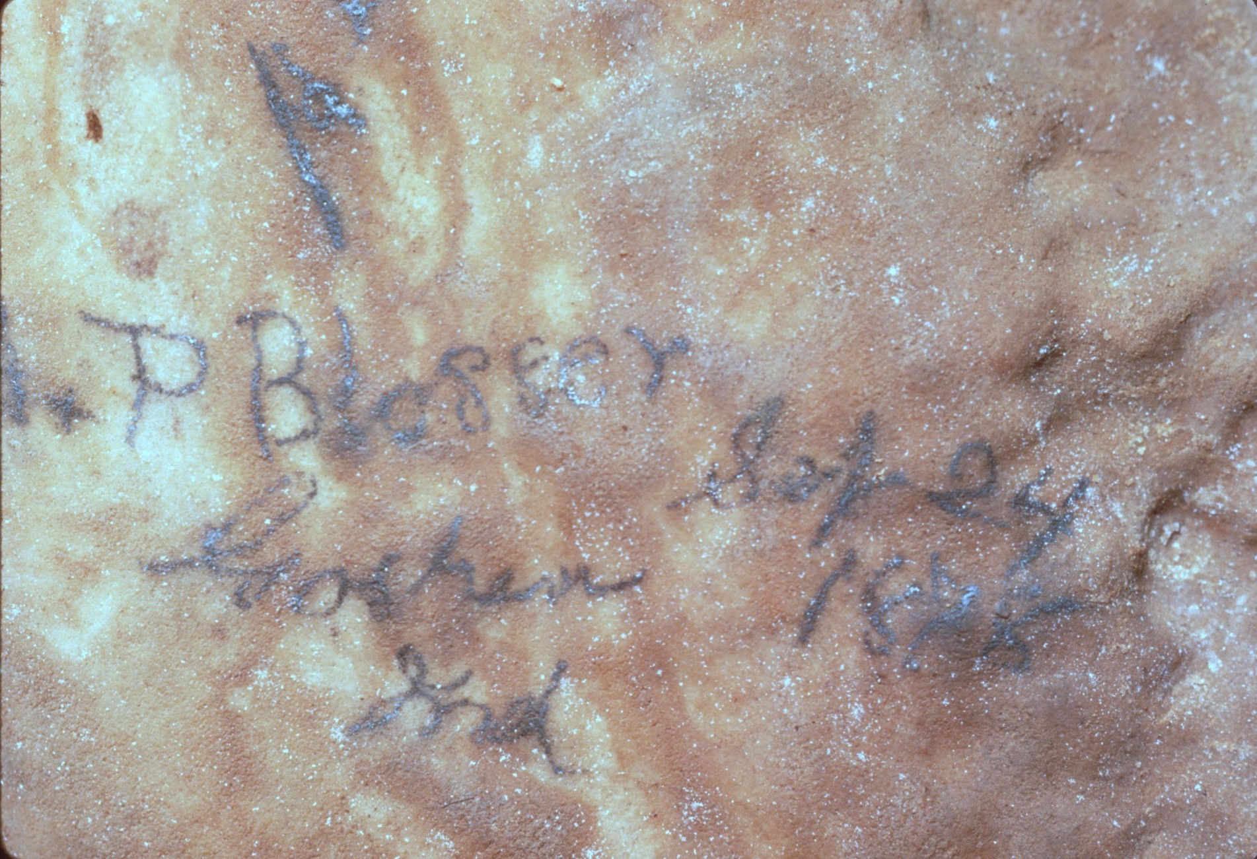

Slide 48
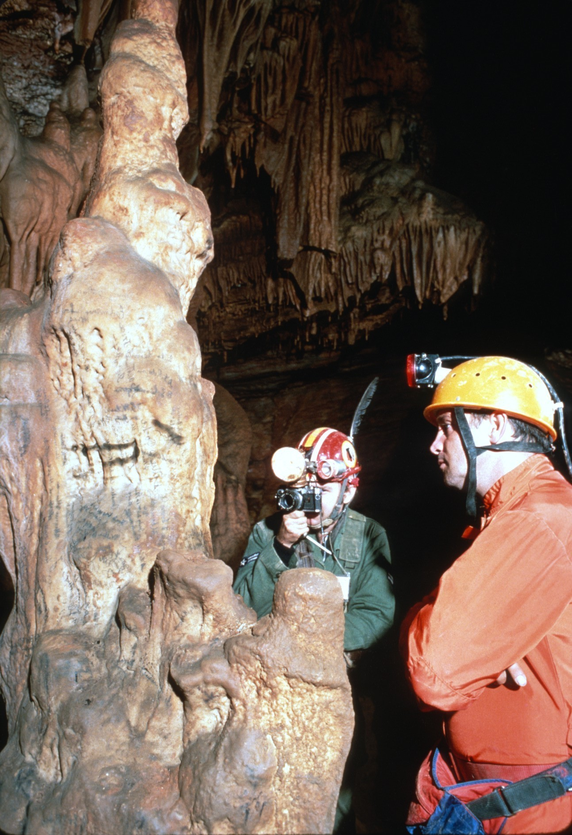
Notes:
They were photographed…

Slide 49
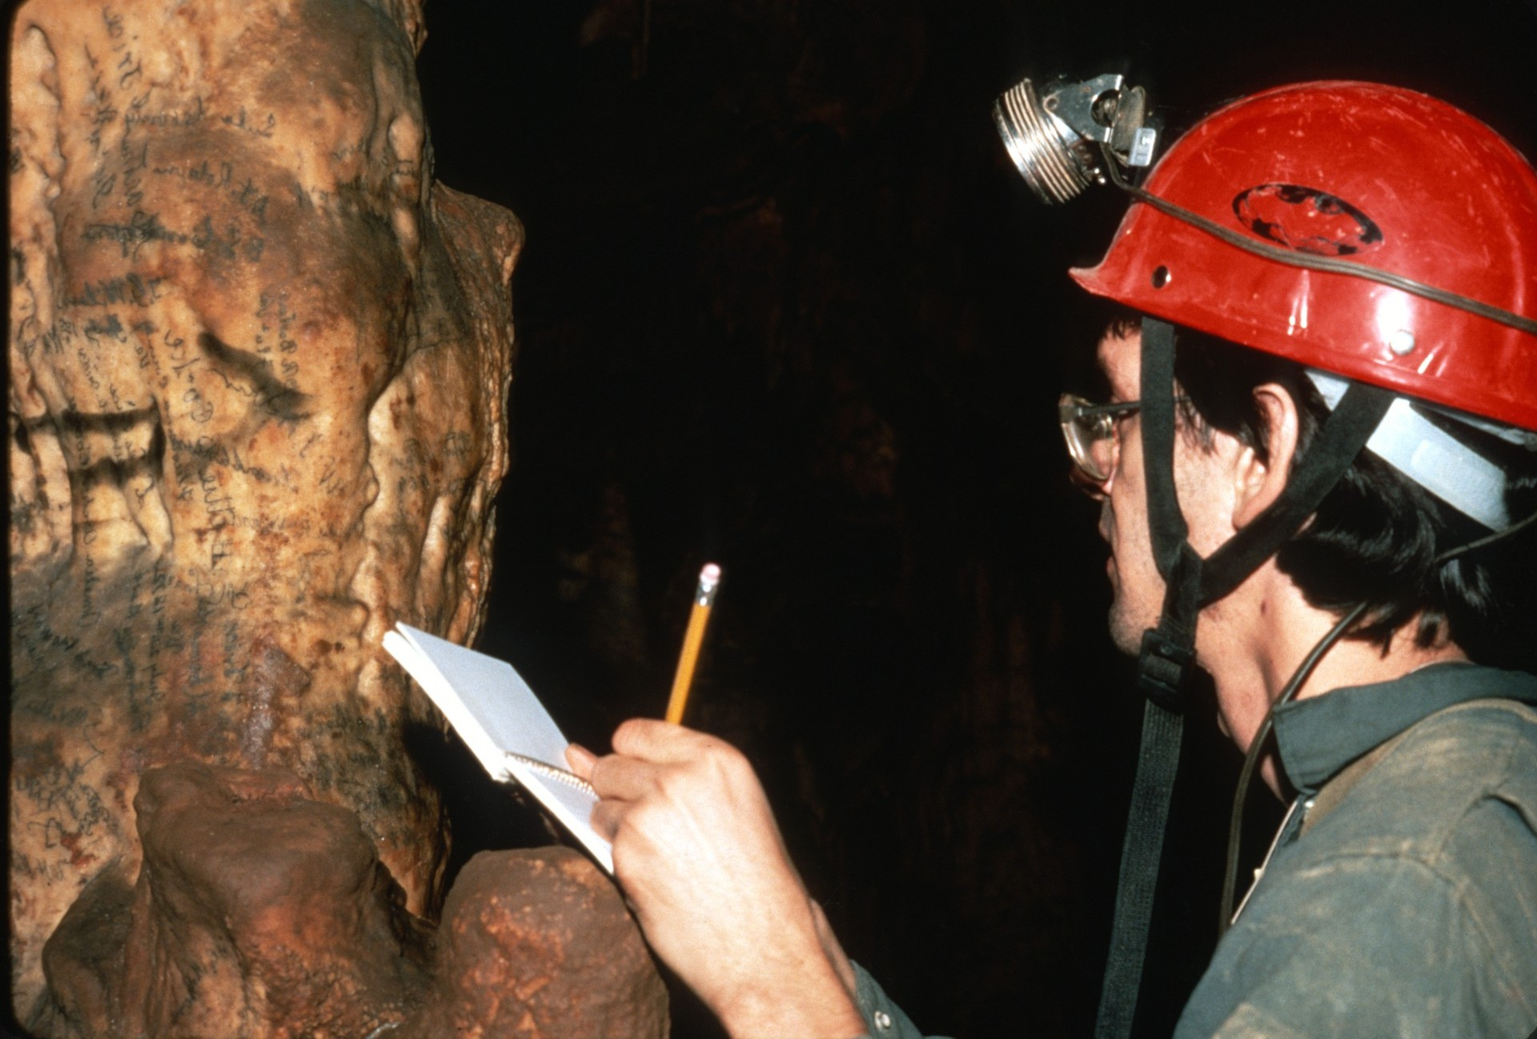
Notes:
…or copied…

Slide 50
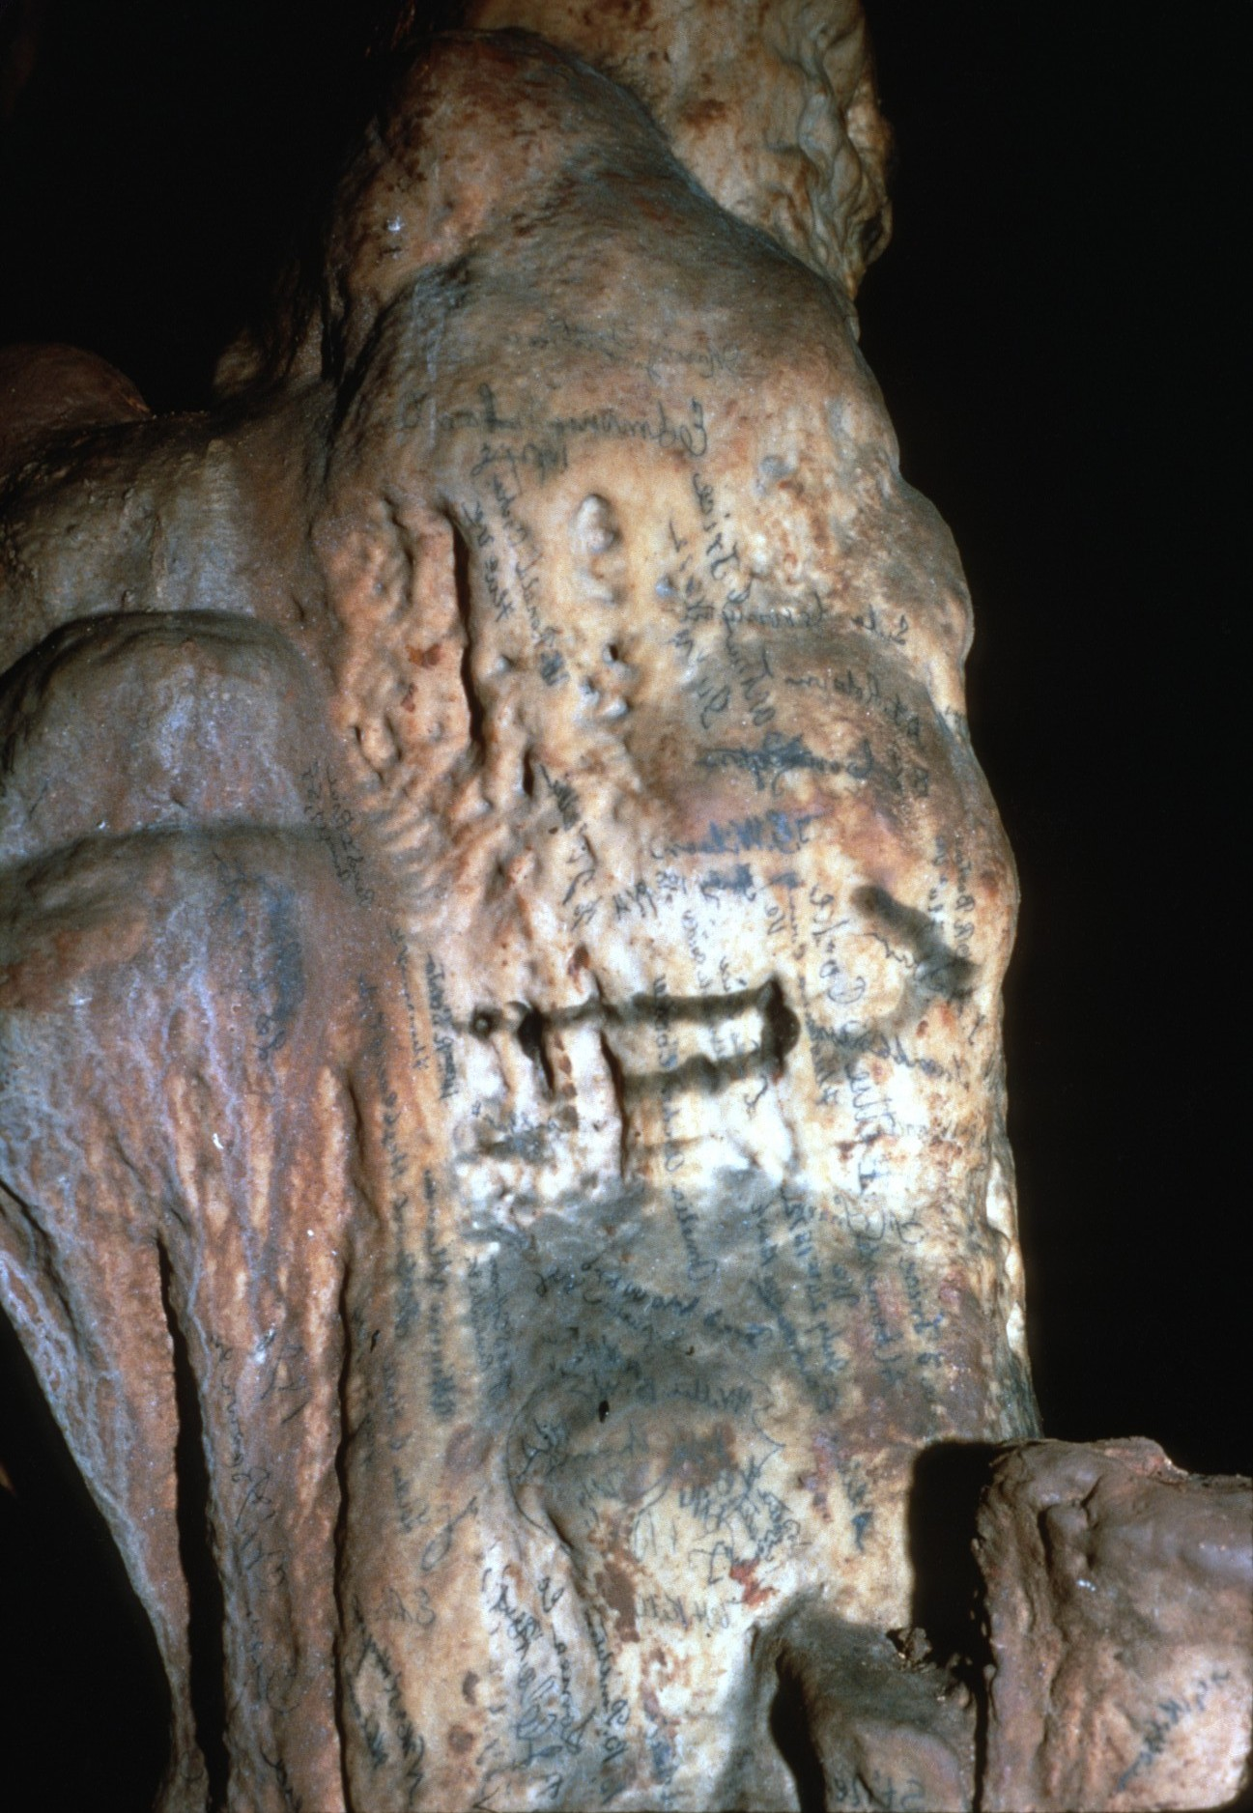
Notes:
…before being removed.

Slide 51
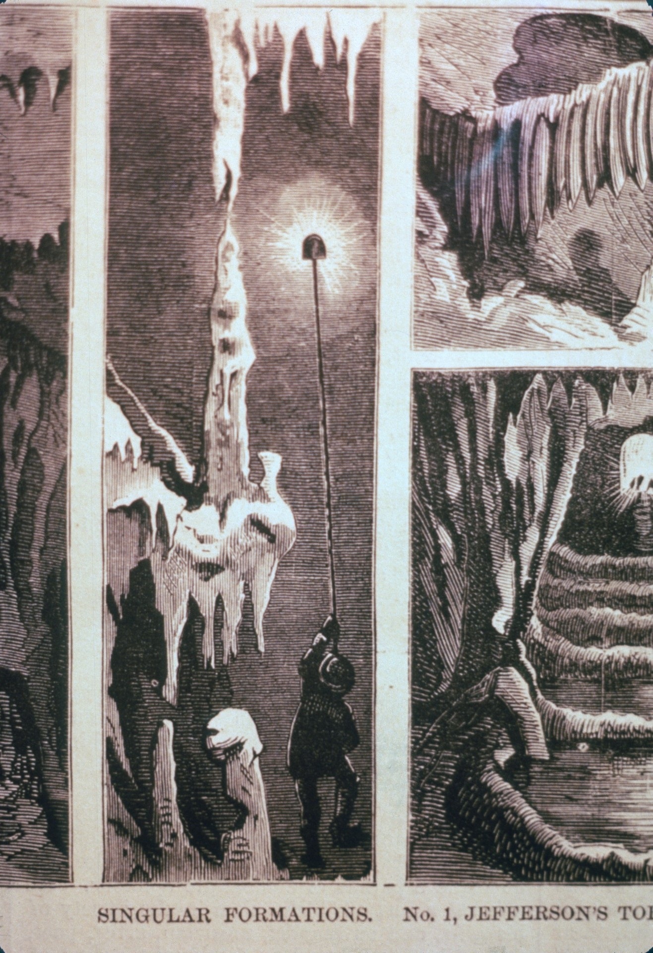
Notes:
In the 1800s Fountain Cave was a popular commercial cave and its beauty was advertised in many of the popular periodicals of the time. However, since then this formation had been broken into several pieces by vandals.

Slide 52
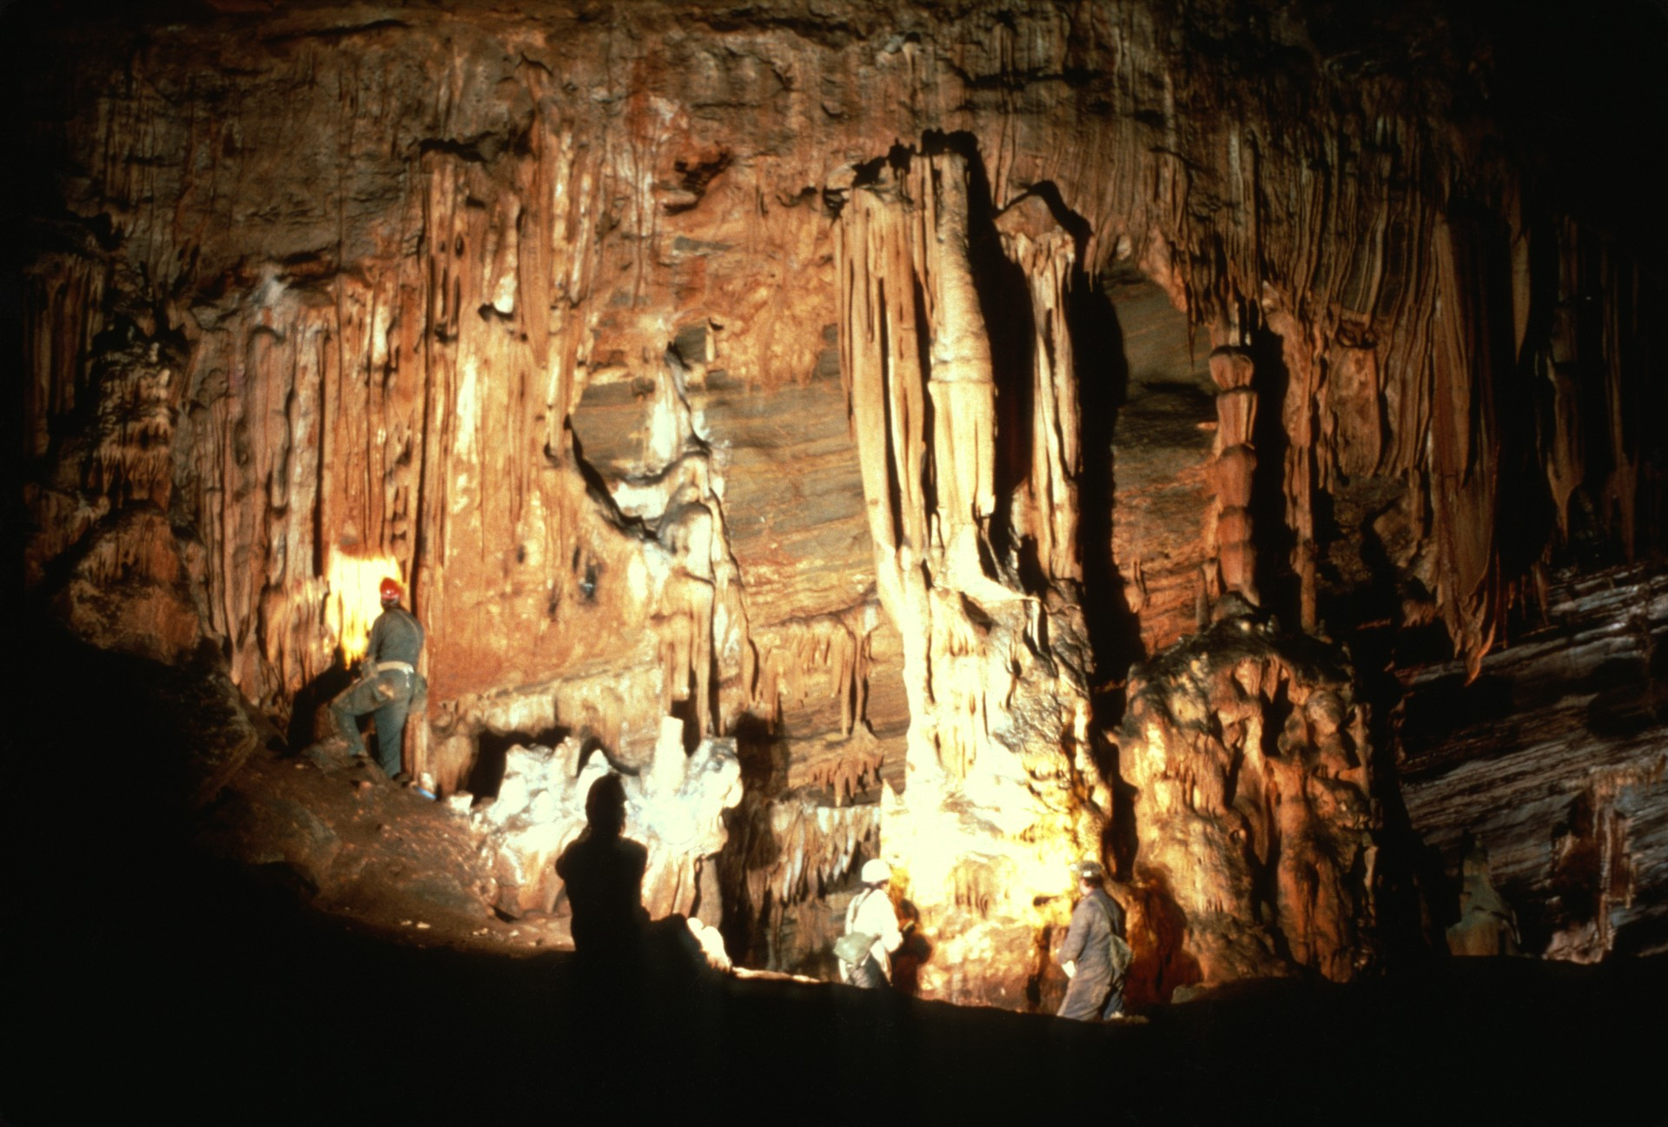
Notes:
With the enthusiasm of the cave restoration running high, several cavers decided to rebuild the stalagmite. After cleaning the stub that remained…

Slide 53
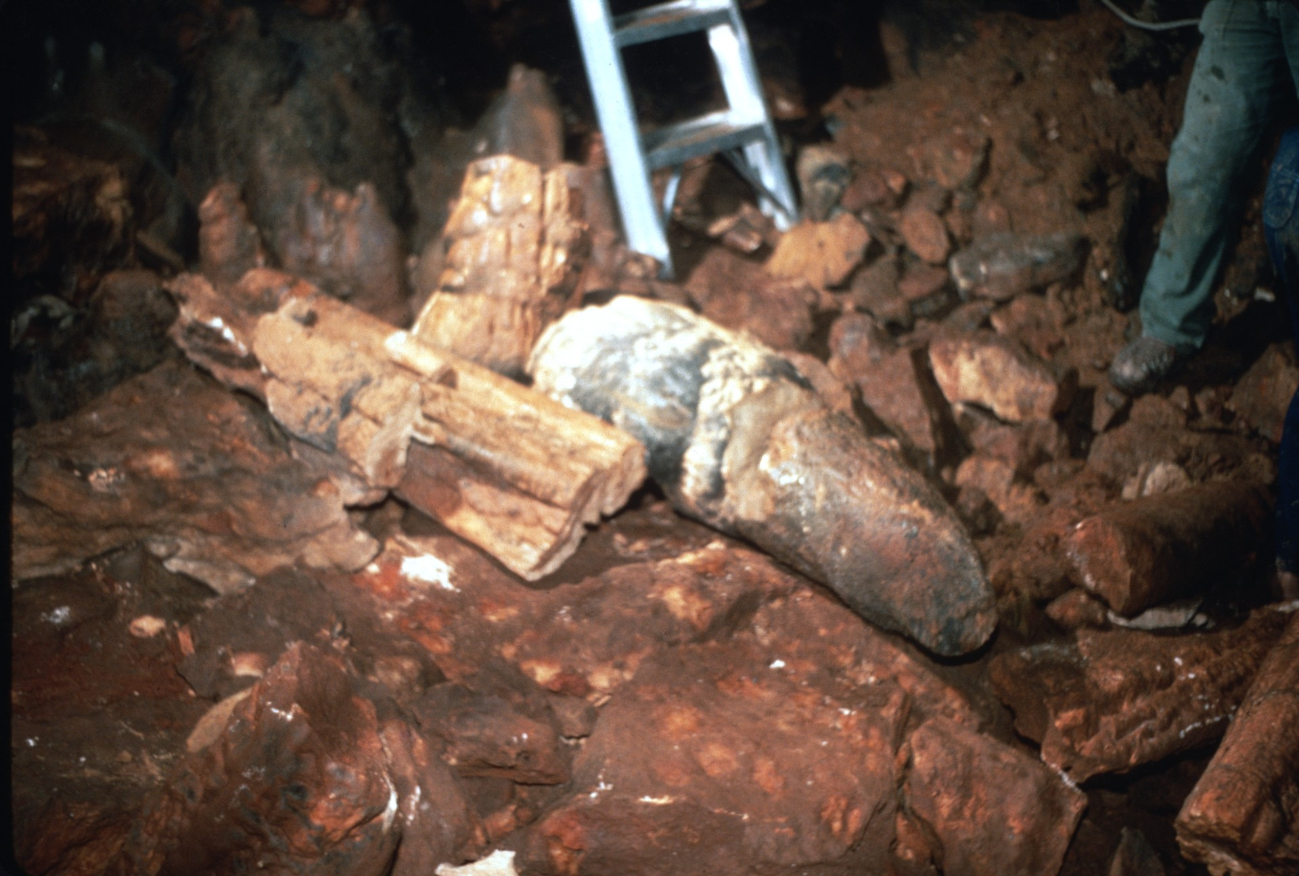
Notes:
…the bottom piece…

Slide 54
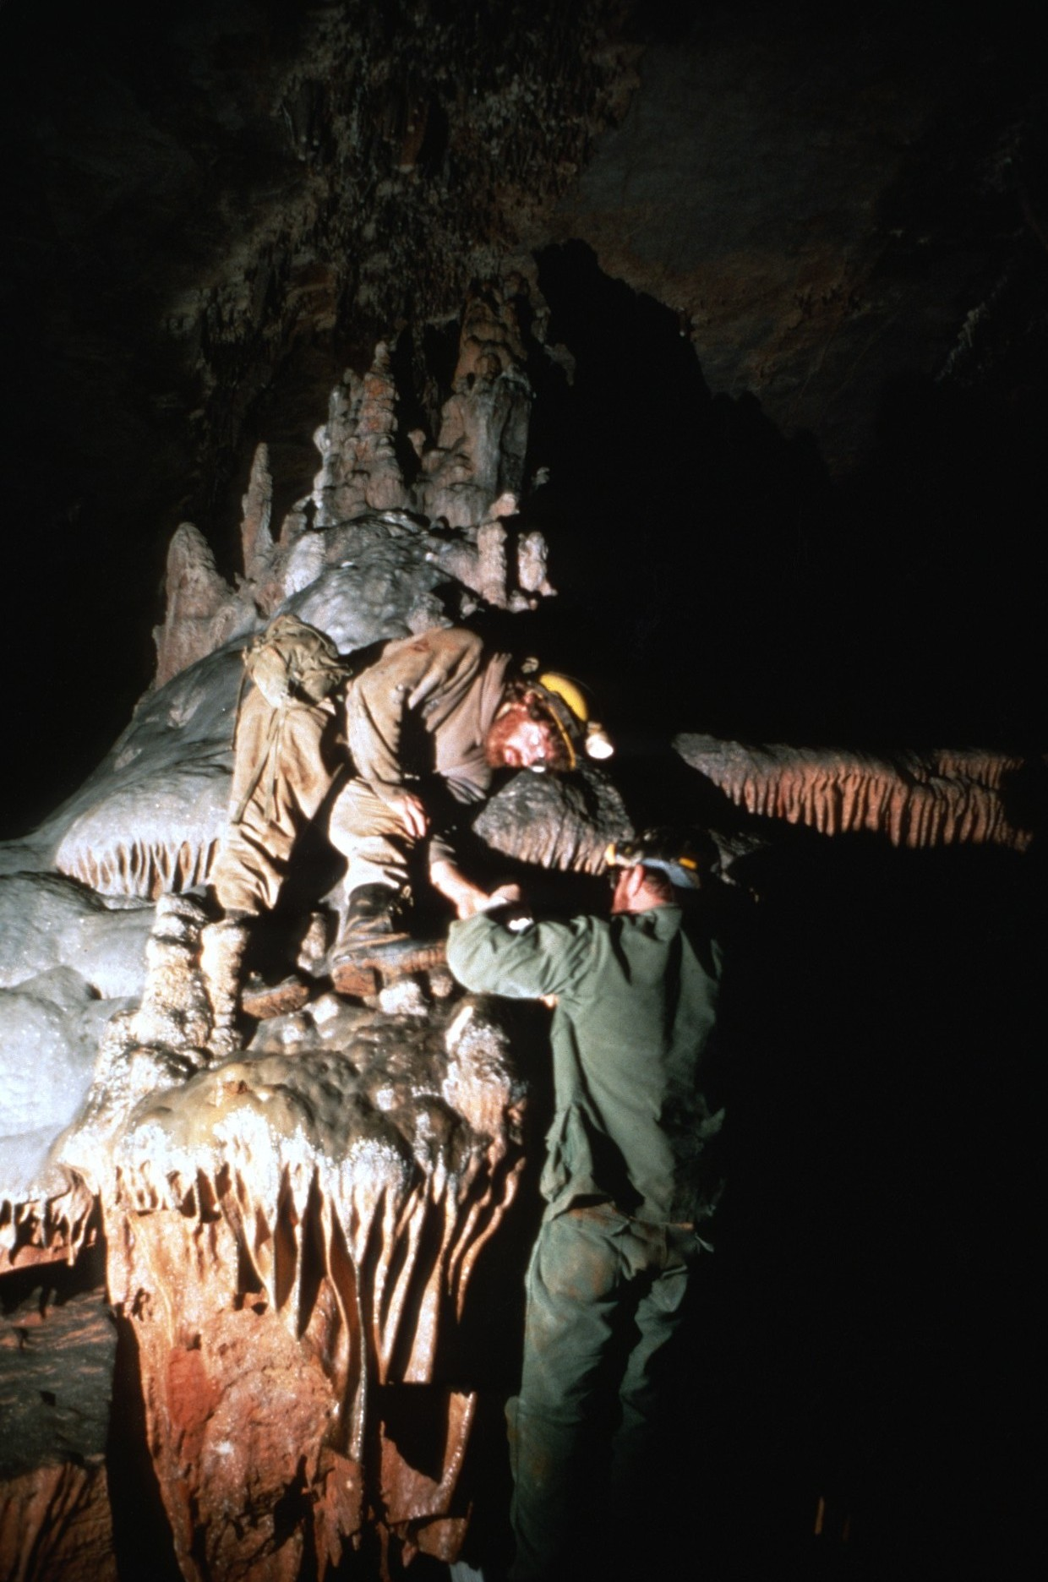
Notes:
…was carefully lifted to its original position.

Slide 55
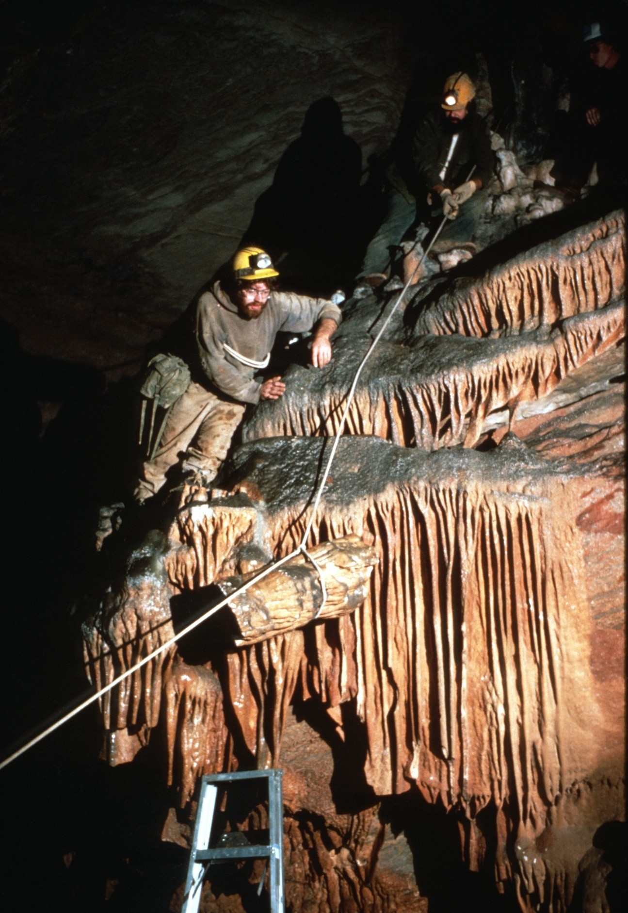

Slide 57
Notes:
Quick setting cement was applied at the base of the piece…

Slide 58
Notes:
and the excess was washed off.

Slide 59
Notes:
The next piece was found and

Slide 60
Notes:
hauled into place.

Slide 62
Notes:
Once in place, cement was applied to its base.

Slide 67
Notes:
The supporting ropes were removed. Meanwhile a local TV station crew was taping the entire event.

Slide 70
Notes:
After supper and a long day restoring the cave, everyone gathered in Grand Caverns, a nearby commercial cave, for an evening of cave songs.

Slide 73
Organize Your Own
CONCAVE
Restore a Cave!
Notes:
CONCAVE #1 was a success. Much of Fountain Cave was restored and the local press highlighted the need for cave conservation. All of us who participated had a great time. Why don’t you consider organizing your own CONCAVE? Get the spirit, restore a cave!

Slide 74
An NSS Audio-Visual Library Presentation
ConCave I
Original slide program S203
Photography by Chip Clark and
Paul & Lee Stevens
Slides digitized by David Caudle
PowerPoint program created by Jim McConkey
74 slides, with script in presenter notes
PowerPoint created 1/21/2021
National Speleological Society
6001 Pulaski Pike
Huntsville, AL 35810-1122
256- 852-1300
nss@caves.org
https://caves.org/

